Slide 1
Unit - II - Elements of IoT
Application Sensors & Actuators - Edge Networking (WSN) – Gateways - IoT Communication Model – WPAN & LPWA, IoT platform for available applications, Hardware Devices: Arduino, Raspberry pi and Intel galileo-Wearable Development Boards.

Slide 2
Connected Devices
Central Control Hardware
Data Cloud
User Interface
Network Interconnection
System Security
Data Analytics

Slide 3
Connected Device
Devices are the primary physical objects connected to the system. For Asset Control Systems, sensors are the components of the device connectivity layer.
These smart sensors are continuously collecting data from the environment and transmit the information to the next layer.
Latest techniques in the semiconductor technology are capable of producing micro smart sensors for various applications.

Slide 4
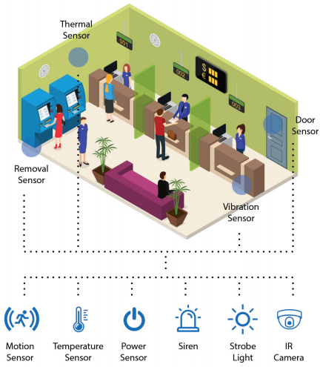
Connected Devices

Slide 5
Central Control Hardware
A Control Panel manages the two-way data traffic between different networks and protocols.
Another function of the control panel is to translate different network protocols and make sure interoperability of the connected devices and sensors.

Slide 6
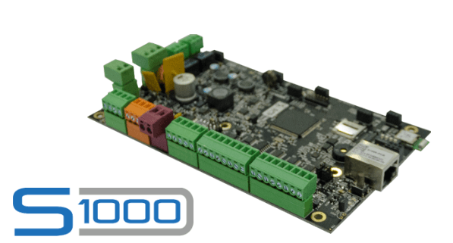
Central Control Hardware

Slide 7
Data Cloud
Internet of things creates massive data from devices, applications and users which has to be managed in an efficient way.
IoT cloud offers tools to collect, process, manage and store huge amount of data in real time. Industries and services can easily access these data remotely and make critical decisions when necessary.

Slide 8
Basically, IoT cloud is a sophisticated high-performance network of servers optimized to perform high-speed data processing of devices, traffic management and deliver accurate data analysis.
Distributed management database systems are one of the indispensable components of IoT cloud.

Slide 9
User Interface
User interfaces are the visible, tangible part of the IoT system which can be accessible by users.
Designers will have to make sure a well-designed user interface for minimum effort for users and encourage more interactions.

Slide 10
User Interface
User interface design has higher significance in today’s competitive market; it often determines the user whether to choose a particular device or appliance.
Users will be interested in buying new devices or smart gadgets if it is very user-friendly and compatible with common connectivity standards.

Slide 11
User Interface
User interface design has higher significance in today’s competitive market; it often determines the user whether to choose a particular device or appliance.
Users will be interested in buying new devices or smart gadgets if it is very user-friendly and compatible with common connectivity standards.

Slide 12
User Interface
User interface design has higher significance in today’s competitive market; it often determines the user whether to choose a particular device or appliance.
Users will be interested in buying new devices or smart gadgets if it is very user-friendly and compatible with common connectivity standards.

Slide 13
Network Interconnection
The IoT’s major significant trend in recent years is the explosive growth of devices connected and controlled by the internet.
The wide range of applications for IoT technology means that the specifics can be very different from one device to the next, but there are basic characteristics shared by most.
There are many technologies that enable IoT. Crucial to the field is the network used to communicate between devices of an IoT installation, a role that several wireless or wired technologies may fulfil.

Slide 14
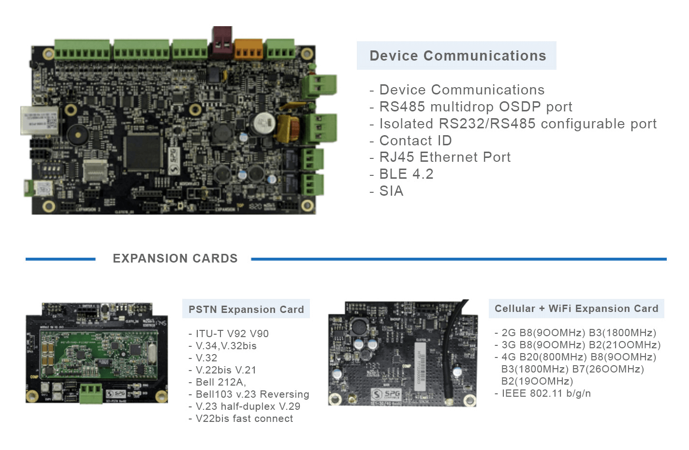
Network Interconnection

Slide 15
System Security
Security is a critical element of IoT deployment, yet it is too often neglected in the development of systems. Everyday vulnerabilities in IoT are being exploited with malicious intent – yet the vast majority of them can be prevented simply and cost-effectively.
A secure system starts with the practice of eradicating vulnerabilities in IoT devices and equipping them with the means to resist, detect and recover from malicious attacks.

Slide 16
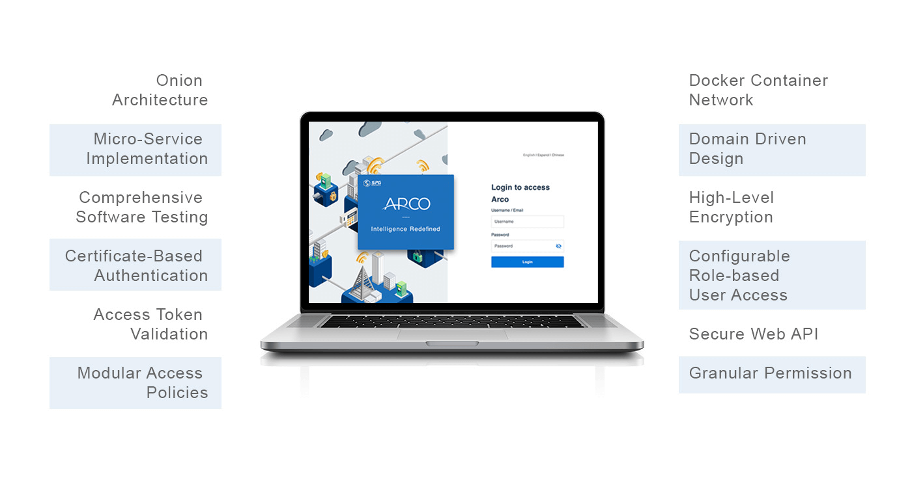
System Security

Slide 17
Data Analytics
Analytics is the process of converting analogue data from interconnected smart devices and sensors into usable insights that can be processed, interpreted and used for detailed analysis. Intelligent analytics are inevitable for IoT technology for management and improvement of the entire system.

Slide 18
Data Analytics
One of the utmost advantages of an efficient IoT system is real-time smart analytics which helps engineers to find out irregularities in the collected data and act fast to prevent an undesired scenario.
Service providers can prepare for further steps if the information is collected accurately at the right time.

Slide 19
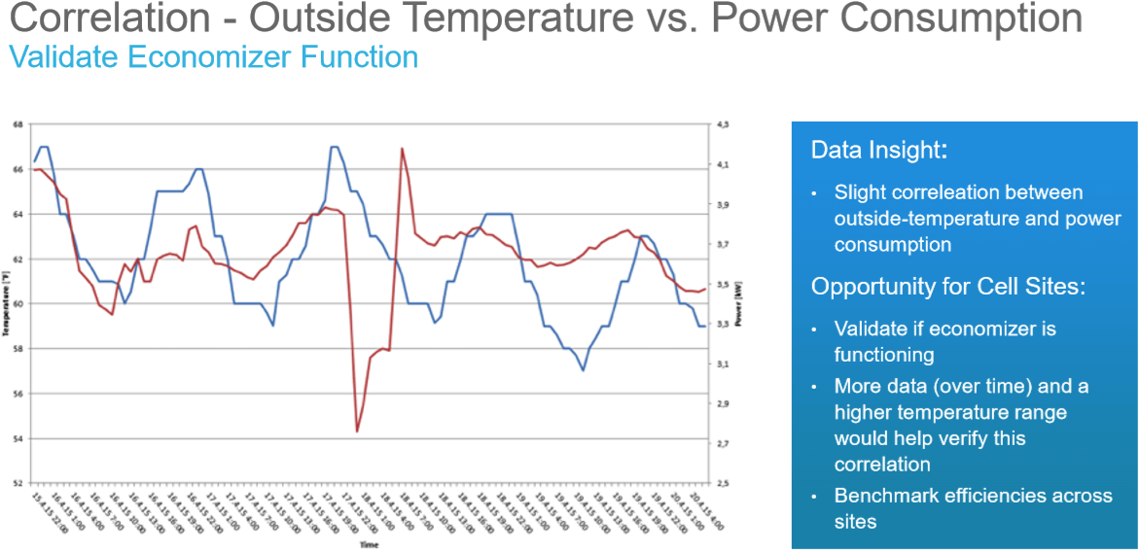
Data Analytics

Slide 20
Application Sensors & Actuators
Sensors and Actuators are important to IoT
- A sensor, also called a transducer, is a device whose task is to detect events or changes in its immediate environment and convert these physical phenomena (like temperature, light, air humidity, movement, presence of chemical substances and many others) which then can be meaningfully interpreted.

Slide 21
Application Sensors & Actuators
An actuator, on the other hand, can be seen as a tool which functions inversely to the sensor.
By interpreting the control system and converting them into mechanical motion, it actually introduces changes to its physical surroundings by means of a variety of simple actions, including but not limited to opening and closing valves, changing other devices’ position or angle, activating them or emitting sounds or light. In simpler terms, the actuator is referred to as a ‘mover’.

Slide 22
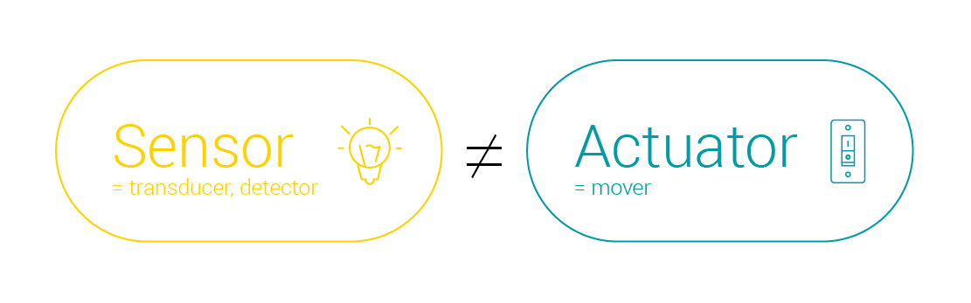

Slide 23
Application Sensors & Actuators IoT sensors types
Sensors can be either standalone devices or devices embedded in ordinary objects or machines to make them smart, and they can be divided into categories in terms of the physical phenomenon they are intended to measure.

Slide 24
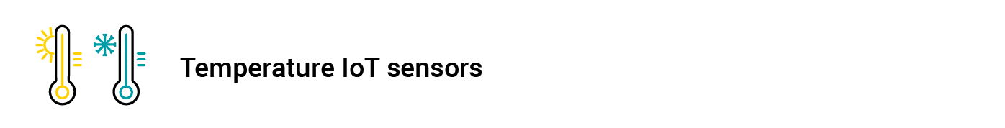

Slide 25
Temperature Sensor
This most basic type of sensor finds its application in every kind of IoT use case where keeping track of thermal conditions of air, work environment, machines or other objects is vital.
Temperature sensors are particularly useful in manufacturing plants, warehouses, weather reporting systems and agriculture, where soil temperature is monitored to provide balanced and maximized growth.

Slide 26
Thermistor: A type of resistor, whose resistance (resistance) depends significantly on the temperature. Thermistors are widely used as sensors in electronics, e.g. as temperature sensors in electronic thermometers or in systems preventing excessive current increase.

Slide 27
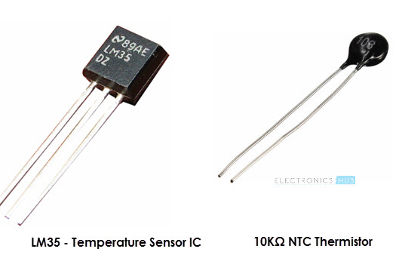
Thermistor

Slide 28
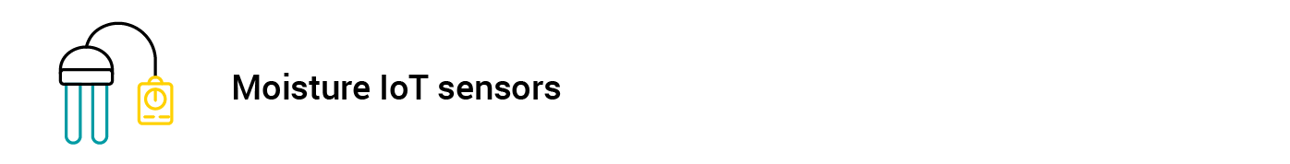

Slide 29
Moisture Sensor
Moisture and humidity sensors are also being extensively employed in agriculture, environment monitoring, food supply chain, Heat,Ventilation,Airconditioning(HVAC)and health monitoring.

Slide 30
Hair tension moisture sensor: A traditional and the oldest type of a moisture sensor. The design of the device is based on the specific properties of human or horse hair, although currently, synthetic or cotton fibers are also used.
These fibers change their length upon contact with moisture. The pointer, which shows the reading on the scale, is connected to the hair (or fiber) and reacts to a change in its length. The undoubted advantage of this type of moisture sensor is a simple and cheap construction, which is also resistant to damage.

Slide 31
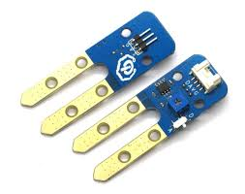
Hair tension moisture sensor

Slide 32
Psychrometer: The construction of this type of device is based on two thermometers (the so-called "dry" and "wet"). The wet thermometer has a mercury container lined with moisture-wicking material.
It uses the phenomenon of damping evaporation by moist air and accelerating it by dry air. The higher the humidity, the lower the temperature of the wet thermometer. The dry thermometer shows the ambient temperature and the humidity can be calculated from the temperature difference.

Slide 33
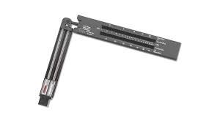
Psychrometer

Slide 34


Slide 35
Depending on ambient light intensity, smart TVs, mobile phones or computer screens are able to adjust their brightness thanks to light sensors, yet sensors for detecting ambient light are not only commonplace in consumer electronics, but also smart city applications.

Slide 36
Photoresistor: it’s a photosensitive element, whose resistance changes through radiation. It can easily be connected to for example Arduino as an analog light sensor. Thanks to this it is possible to build e.g. lamps that turn on automatically after dark. Photoresistors can also be used as very simple proximity sensors or even temperature sensors

Slide 37
Photodiode: A diode which works based on photoelectric effect. When photons reach the junction of a photodiode they are absorbed, which results in the electron being transferred to the conductivity band to create an electron-hole pair. Photodiodes are widely used in industrial automation (signaling and control systems), telecommunications and many more industries.

Slide 38
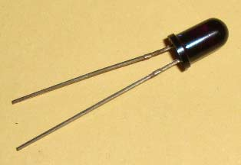
PHOTO DIODE

Slide 39
Smart acoustic sensors enable us to monitor the level of noise in a given environment. Being able to measure and provide data to help noise pollution prevention, acoustic IoT sensor systems are gaining ground in smart city solutions.

Slide 40
Hydrophone: a microphone used to pick up sounds propagating in water or other liquids. Hydrophones are a basic structural element of passive sonars used for example to detect fish in various aquatic environments.
Geophone: it is a sensor that converts ground vibrations (frequency and amplitude) into electrical voltage. You can say it’s a type of a seismometer.

Slide 41
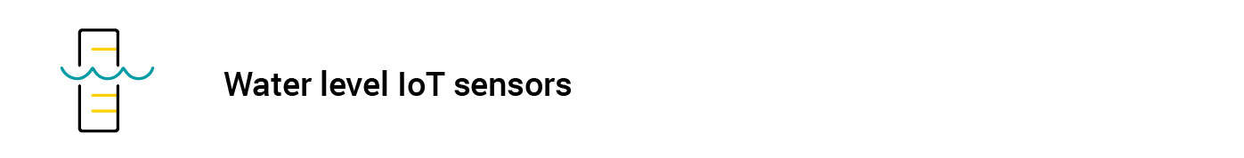

Slide 42
To prevent natural disasters, data gathered by the water level monitoring sensors can be used in flood warning systems for analytics and prediction. Apart from environmental protection, this sensor finds its use in a variety of industrial applications to control and optimize manufacturing processes.

Slide 43
Hydrostatic pressure sensor: used to measure the level of liquid filling. These sensors operate based on level measurements using the so-called hydrostatic paradox – the hydrostatic pressure measured at the tank measuring point is proportional only to the height of the liquid filling, regardless of the shape and volume of the tank.

Slide 44
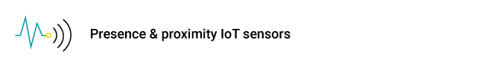

Slide 45
By emitting an electromagnetic radiation beam, this type of sensor is capable of sensing its target object presence and determining the distance that separates both. With their high reliability and long life, it is no wonder that they have quickly made it into so many IoT sectors, such as smart cars, robotics, manufacturing, machines, aviation, and even smart parking solutions.

Slide 46
Doppler radar: radar that uses the Doppler effect i.e. the difference in the frequency of the wave sent by its source and the frequency of the wave recorded by the observer who moves relative to this source. The radar is used not only to detect objects and determine their location, but also to learn about their direction and speed.
Occupancy sensor: a type of presence sensor that uses either infrared light or high frequencies to detect movement in office and sanitary facilities, corridors, passages, warehouses etc.

Slide 47
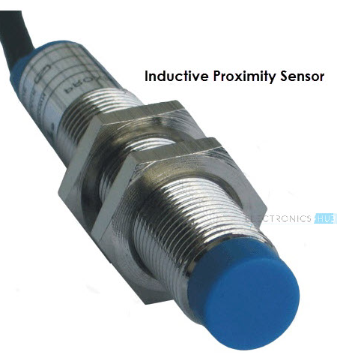
PROXIMITY SENSOR

Slide 49
A smart building system is probably the most banale IoT application for the motion sensor to imagine. While this obviousness holds largely true, apart from helping to monitor private or public spaces from intrusion and burglary, the use of motion sensors is extending to energy management solutions, smart cameras, automated devices and many others.

Slide 50
Active, ultrasonic motion sensor: sending and receiving ultrasonic passive waves
Passive, infrared motion sensor: detecting changes in infrared radiation
Active, radar sensor: emitting and receiving electromagnetic waves
There are also sensor versions that combine all of the above motion-related principles.
Example is a passive infrared sensor (PIR): electronic sensor used for motion detection, which is commonly used in alarm systems, automatic lighting and ventilation systems etc.

Slide 51
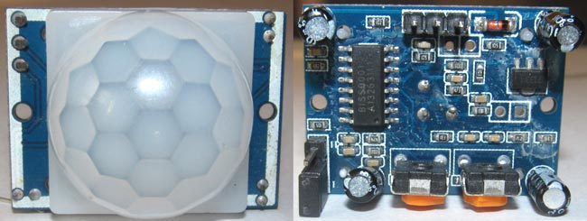
PIR SENSOR

Slide 52


Slide 53
The task of this type of sensor is to detect rotation and measure angular velocity, which makes it perfect for navigation systems, robotics, consumer electronics and manufacturing processes involving rotation. For a more day-to-day IoT application, gyroscope sensors are increasingly installed in IoT devices used by athletes for accurate measurements of body movements to analyse and improve their sports performance.

Slide 54
Heading indicator: a directional gyroscope or heading indicator allows you to observe the rotation of the body to which it is attached. The gyroscope is most often made as a fast rotating rigid object (usually a disk) suspended in a suitable structure enabling its free rotation with respect to the reference system (e.g. the body to which it is attached).

Slide 55
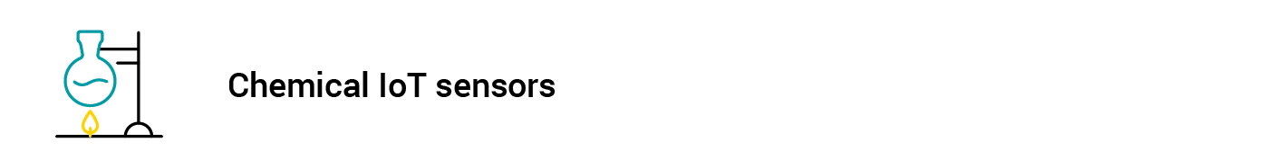

Slide 56
Sensors able to detect chemical compounds (solids, liquids, and gases) are indispensable elements in industrial security systems, environmental protection solutions, and, quite obviously, scientific research. Moreover, they have already gained a foothold in IoT-supported air quality monitoring which helps cities and states fight the harmful impact of air and water pollution.

Slide 57
Electrochemical breathalyzer: a simple sensor used to determine the alcohol content in blood. The electrochemical sensor is resistant to side effects such as menthol, cigarette smoke or citric acid and can indicate alcohol concentration in the exhaled air with an accuracy of 0.000 ‰.

Slide 58
Electronic nose: a chemical detector, or rather a set of detectors, that reacts to different types of particles contained in the environment or their different characteristics (such as the presence of specific chemical bonds, acidity, alkalinity, the ability to stabilize neighboring dipoles, etc.). Information obtained by using such a set of detectors makes it possible to learn about the chemical composition of the environment.

Slide 59
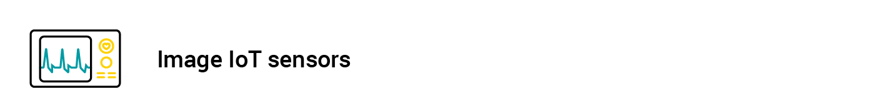

Slide 60
Converting optical data to electrical impulses, an image sensor enables the connected object to view the environment around it and act upon it using the intelligence obtained from the analysis of data provided.
Image sensors are used whenever there is a need for the smart device to ‘see’ its immediate surroundings, which includes smart vehicles, security systems, military equipment like radars and sonars, medical imaging devices and, of course, digital cameras.

Slide 61
Active-pixel sensor: arrangement of many photosensitive elements made in CMOS technology. CMOS sensors are found in many devices such as webcams, compact digital cameras, DSLR (Digital Single Lens Reflex) cameras, control elements in production automation, digital x-ray cameras, and more.
Charge-coupled device: a system of many photosensitive elements that register and then enable reading an electric signal proportional to the amount of light falling on it. Color filters used in CCD sensors can be very often found in digital cameras giving them the ability to record the intensity of a specific width of the light spectrum at a given point of the matrix.

Slide 62
IoT actuator types
Actuators, as the name itself suggests, can act on their immediate environment to enable correct operation of the machines or devices they are embedded into.
Small as they are, they are rarely visible during operation, but the effects of their work can be felt in vehicles, industrial machines or any other electronic equipment involving automation technologies.

Slide 63
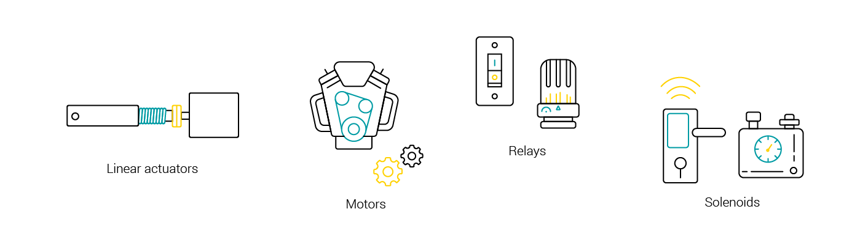

Slide 64
Linear actuators – these are used to enable motion of objects or elements in a straight line.
Motors – they enable precise rotational movements of device components or whole objects.
Relays – this category includes electromagnet-based actuators to operate power switches in lamps, heaters or even smart vehicles.
Solenoids – most widely used in home appliances as part of locking or triggering mechanisms, they also act as controllers in IoT-based gas and water leak monitoring systems.

Slide 65
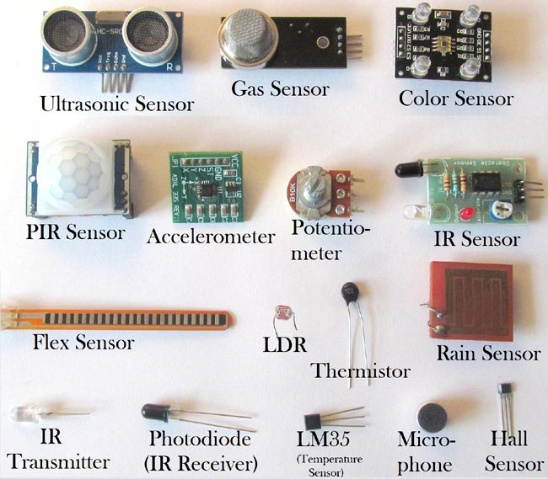

Slide 66
Edge Networking
Embedded systems are already playing a crucial role in the development of the IoT. In broad strokes, there are four main components of an IoT system:
- The Thing itself (the device)
- The Local Network; this can include a gateway,
which translates proprietary communication
protocols to Internet Protocol
- The Internet
- Back-End Services, enterprise data systems, or PCs
and mobile devices

Slide 67
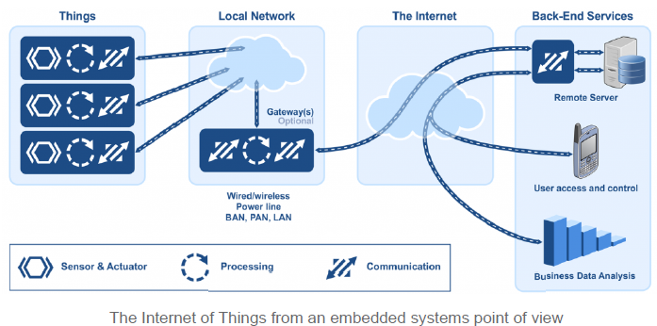
Embedded Point of View:

Slide 68
Internet of Things in two broad categories:
Industrial IoT, where the local network is based on any one of many different technologies.
The IoT device will typically be connected to an IP network to the global Internet.
Commercial IoT, where local communication is typically either Bluetooth or Ethernet (wired or wireless). The IoT device will typically communicate only with local devices

Slide 69
Local Network: IoT devices are deployed in so many different ways — in clothing, houses, buildings, campuses, factories, and even in your body — that no single networking technology can fit all bills.
Let’s take a factory as a typical case for an IoT system. A factory would need a large number of connected sensors and actuators scattered over a wide area, and a wireless technology would be the best fit.

Slide 70
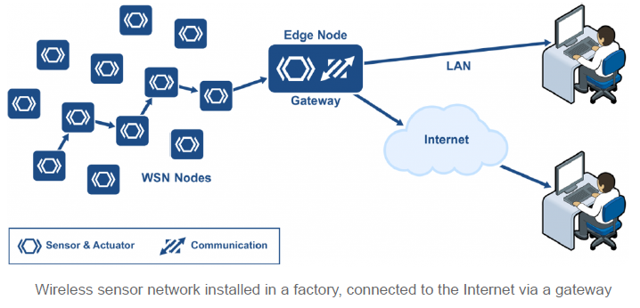
Wireless Sensor Network Architecture

Slide 71
A wireless sensor network (WSN) is a collection of distributed sensors that monitor physical or environmental conditions, such as temperature, sound, and pressure. Data from each sensor passes through the network node-to-node.

Slide 72
WSN Nodes
WSN nodes are low cost devices, so they can be deployed in high volume. They also operate at low power so that they can run on battery, or even use energy harvesting. A WSN node is an embedded system that typically performs a single function (such as measuring temperature or pressure, or turning on a light or a motor).

Slide 73
Energy harvesting is a new technology that derives energy from external sources (for example, solar power, thermal energy, wind energy, electromagnetic radiation, kinetic energy, and more). The energy is captured and stored for use by small, low-power wireless autonomous devices, like the nodes on a WSN.

Slide 74
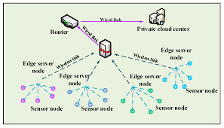
WSN Edge Nodes

Slide 75
A WSN edge node is a WSN node that includes Internet Protocol connectivity. It acts as a gateway between the WSN and the IP network. It can also perform local processing, provide local storage, and can have a user interface.

Slide 76
WSN Technologies
The battle over the preferred networking protocol is far from over. There are multiple candidates.
Wi-Fi
The first obvious networking technology candidate for an IoT device is Wi-Fi, because it is so ubiquitous. Certainly, Wi-Fi can be a good solution for many applications. Almost every house that has an Internet connection has a Wi-Fi router.

Slide 77
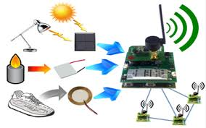

Slide 78
Internet of Things (IoT) Gateways
Gateway provides bridge between different communication technologies which means we can say that a Gateway acts as a medium to open up connection between cloud and controller(sensors / devices) in Internet of Things (IoT). By the help of gateways it is possible to establish device to device or device to cloud communication. A gateway can be a typical hardware device or software program.

Slide 79
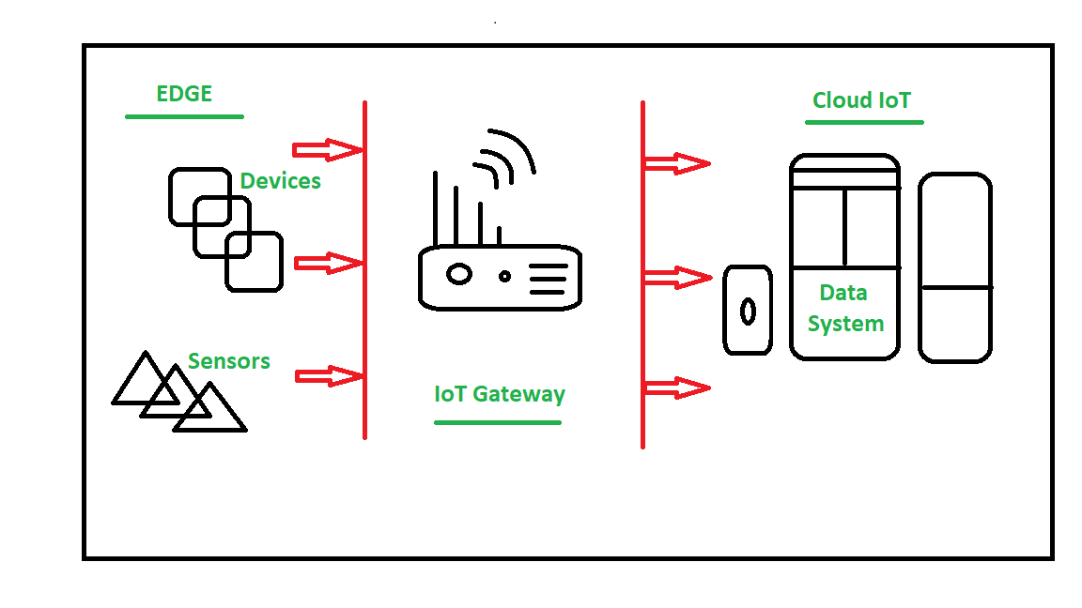
Gateways

Slide 80
Key functionalities of IoT Gateway
Establishing communication bridge
Provides additional security.
Performs data aggregation.
Pre processing and filtering of data.
Provides local storage as a cache/ buffer.

Slide 81
Data computing at edge level.
Ability to manage entire device.
Device diagnostics.
Adding more functional capability.
Verifying protocols.

Slide 82
Working of IoT Gateway
Receives data from sensor network.
Performs Pre processing, filtering and cleaning on unfiltered data.
Transports into standard protocols for communication.
Sends data to cloud.

Slide 83
Communication Models in IoT

Slide 84
. Communication models used in IoT have great value. The IoTs allow people and things to be connected any time, any space, with anything and anyone, using any network and any service.

Slide 85
From an operational perspective, it is useful to think about how IoT devices connect and communicate in terms of their technical communication models. In March 2015, the Internet Architecture Board (IAB) released a guiding architectural document for networking of smart objects which outlines a framework of four common communication models used by IoT devices.

Slide 86
Device-to-Device Communications
The device-to-device communication model represents two or more devices that directly connect and communicate between one another, rather than through an intermediary application server. These devices communicate over many types of networks, including IP networks or the Internet. Often, however these devices use protocols like Bluetooth, Z-Wave, or ZigBee to establish direct device-to-device communications

Slide 87




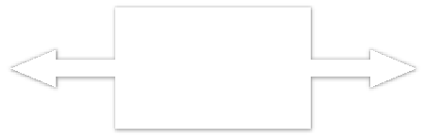

Light Bulb
Wireless Network
Light Switch
Manufacturer A
Bluetooth,Z+Wave,ZigBee
Manufacturer B

Slide 88
These device-to-device networks allow devices that adhere to a particular communication protocol to communicate and exchange messages to achieve their function. This communication model is commonly used in applications like home automation systems, which typically use small data packets of information to communicate between devices with relatively low data rate requirements.

Slide 89
Residential IoT devices like light bulbs, light switches, thermostats, and door locks normally send small amounts of information to each other (e.g. a door lock status message or turn on light command) in a home automation scenario.

Slide 90
From the user’s point of view, this often means that underlying device-to-device communication2 protocols are not compatible, forcing the user to select a family of devices that employ a common protocol.

Slide 91
While these incompatibilities limit user choice to devices within a particular protocol family, the user benefits from knowing that products within a particular family tend to communicate well.

Slide 92
Device-to-Cloud Communications
In a device-to-cloud communication model, the IoT device connects directly to an Internet cloud service like an application service provider to exchange data and control message traffic. This approach frequently takes advantage of existing communications mechanisms like traditional wired Ethernet or Wi-Fi connections to establish a connection between the device and the IP network, which ultimately connects to the cloud service.

Slide 93










HTTP TLS TCP IP
Application Service Provider
CoAP DTLS UDP IP
Device with
Devicewith Carbon
Temperature Monoxide
Sensor Sensor

Slide 94
This communication model is employed by some popular consumer IoT devices like the Nest Labs Learning Thermostat and the Samsung SmartTV. In the case of the Nest Learning Thermostat, the device transmits data to a cloud database where the data can be used to analyze home energy consumption.

Slide 95
Similarly, with the Samsung SmartTVtechnology, the television uses an Internet connection to transmit user viewing information to Samsung for analysis and to enable the interactive voice recognition features of the TV.

Slide 96
However, interoperability challenges can arise when attempting to integrate devices made by different manufacturers. Frequently, the device and cloud service are from the same vendor. If proprietary data protocols are used between the device and the cloud service, the device owner or user may be tied to a specific cloud service, limiting or preventing the use of alternative service providers.

Slide 97
This is commonly referred to as “vendor lock-in’’, a term that encompasses other facets of the relationship with the provider such as ownership of and access to the data. At the same time, users can generally have confidence that devices designed for the specific platform can be integrated.

Slide 98
Device-to-Gateway Model
In the device-to-gateway model, or more typically, the device-to-application-layer gateway (ALG) model, the IoT device connects through an ALG service as a conduit to reach a cloud service.

Slide 99
In simpler terms, this means that there is application software operating on a local gateway device, which acts as an intermediary between the device and the cloud service and provides security and other functionality such as data or protocol translation.

Slide 100
Several forms of this model are found in consumer devices. In many cases, the local gateway device is a Smartphone running an app to communicate with a device and relay data to a cloud service. model employed with popular consumer items like personal fitness trackers.

Slide 101
These devices do not have the native ability to connect directly to a cloud service, so they frequently rely on Smartphone app software to serve as an intermediary gateway to connect the fitness device to the cloud.

Slide 102
The other form of this device-to-gateway model is the emergence of “hub” devices in home automation applications. These are devices that serve as a local gateway between individual IoT devices and a cloud service, but they can also bridge the interoperability gap between devices themselves.

Slide 103
. For example, the Smart Things hub is a stand-alone gateway device that has Z-Wave and Zigbee transceivers installed to communicate with both families of devices. It then connects to the Smart Things cloud service, allowing the user to gain access to the devices using a Smartphone app and an Internet connection. The evolution of systems using the device-to-gateway communication model and its larger role in addressing interoperability challenges among IoT devices is still unfolding.

Slide 104
Back-End Data-Sharing Model
The back-end data-sharing model refers to a communication architecture that enables users to export and analyze smart object data from a cloud service in combination with data from other sources. This architecture supports “the [user’s] desire for granting access to the uploaded sensor data to third parties.

Slide 105
This approach is an extension of the single device-to-cloud communication model, which can lead to data silos where “IoT devices upload data only to a single application service provider’’. A back-end sharing architecture allows the data collected from single IoT device data streams to be aggregated and analyzed.

Slide 106
For example, a corporate user in charge of an office complex would be interested in consolidating and analyzing the energy consumption and utilities data produced by all the IoT sensors and Internet-enabled utility systems on the premises. Often in the single device-to-cloud model, the data each IoT sensor or system produces sits in a stand-alone data silo.

Slide 107
An effective back-end data sharing architecture would allow the company to easily access and analyze the data in the cloud produced by the whole spectrum of devices in the building. Also, this kind of architecture facilitates data portability needs. Effective back-end data- sharing architectures allow users to move their data when they switch between IoT services, breaking down traditional data silo barriers.

Slide 108
The back-end data-sharing model suggests a federated cloud services approach or cloud applications programmer interfaces (APIs) are needed to achieve interoperability of smart device data hosted in the cloud.

Slide 109
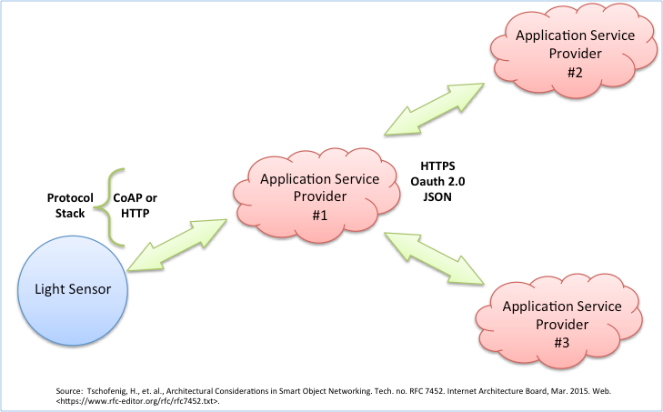

Slide 110
Internet of Things Communications Models Summary
The four basic communication models demonstrate the underlying design strategies used to allow IoT devices to communicate. Aside from some technical considerations, the use of these models is largely influenced by the open versus proprietary nature of the IoT devices being networked.

Slide 111
And in the case of the device-to-gateway model, its primary feature is its ability to overcome proprietary device restrictions in connecting IoT devices. This means that device interoperability and open standards are key considerations in the design and development of internetworked IoT systems.

Slide 112
From a general user perspective, these communication models help illustrate the ability of networked devices to add value to the end user. By enabling the user to achieve better access to an IoT device and its data, the overall value of the device is amplified.

Slide 113
For example, in three of the four communication models, the devices ultimately connect to data analytic services in a cloud computing setting. By creating data communication conduits to the cloud, users, and service providers can more readily employ data aggregation, big data analytics, data visualization, and predictive analytics technologies to get more value out of IoT data than can be achieved in traditional data-silo applications.

Slide 114
In other words, effective communication architectures are an important driver of value to the end user by opening possibilities of using information in new ways. It should be noted, however, these networked benefits come with trade-offs. Careful consideration needs to be paid to the incurred cost burdens placed on users to connect to cloud resources

Slide 115
WPAN and LPWA Technologies for Various IoT Devices and its Applications

Slide 116
An internet connection is a wonderful thing, it give us all sorts of benefits that just weren’t possible before. Think of the cell phone before it was a smartphone.
It could make a call and send text before, but now it is possible to read any book, watch any movie, or listen to any song all in the palm of our hand.

Slide 117
The Internet of Things is actually a pretty simple concept, it means taking all the things in the world and connecting them to the internet.

Slide 118
In the Internet of Things, all the things that are being connected to the internet can be put into three categories:
1) Things that collect information and then send it.
2) Things that receive information and then act on it
3) Things that do both.

Slide 119
Collecting and sending information
Various sensors such as temperature sensors, motion sensors, moisture sensors, light sensors etc. These sensors along with the connection automatically collect information from the environment which is used to make intelligent decisions.

Slide 120
For example on the farm, the moisture sensor automatically collects the moisture content in the soil and tells farmer exactly when the crops need to be watered. The farmer can ensure that crops get exactly the right amount of water. Just as our sight, hearing, smell, touch and taste allows human to make sense of the world sensor allows machines to make sense of the world.

Slide 121
Receive and acting on information
In real life we are familiar with machines getting information and then acting on it.
For example, printer receives a document and prints it. The car receives the signal from car keys and then doors get locked. IoT also works as same as what we do generally in our real life. It is concept of sending a “Print” command from smartphones to 3D printer which prints a 3D model.

Slide 122
Doing both
Let’s consider farming example, the moisture sensor collect the moisture content of the soil and intimates the farmer to water the crops. But actually there is no need of farmer. Instead the irrigation system automatically turns on as needed based on the moisture content in the soil.

Slide 123
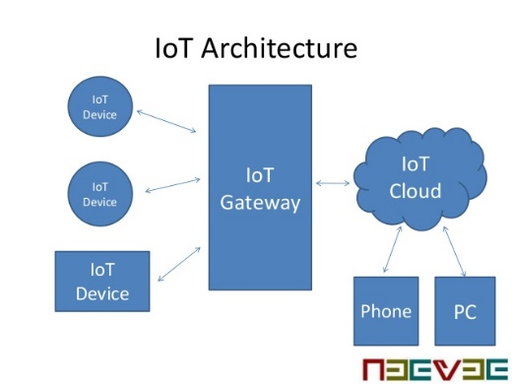

Slide 124
Sensors like Temperature, Humidity, pressure, Motion, Moisture, and Light [2] are used in IoT for monitoring various parameters. These sensors collect information sensed by it and pass through the IoT gateway and reaches the cloud server via various wireless technologies.

Slide 125
Bluetooth
Bluetooth is a wireless Personal Area Network (WPAN) Technology for short range communication.
The concept behind Bluetooth is to provide a universal short-range wireless capability. Using the 2.4 GHz ISM band, available globally for unlicensed low-power uses, two Bluetooth devices within 10 m of each other can share up to 721 Kbps of capacity. It is a technology that comes as an alternative to cables for connecting portable and fixed electronic devices.

Slide 126
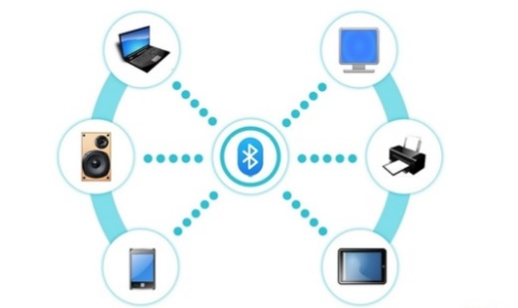

Slide 127
Bluetooth technology plays a vital role in wireless devices in our day to day life. Some of the Bluetooth devices are 1) Bluetooth headset 2) Stereo headset 3) In car Bluetooth 4) Bluetooth keyboard 5) Bluetooth webcam 6) Bluetooth GPS 7) Bluetooth printer. These devices operates in short range communication

Slide 128
Bluetooth ≈ IEEE 802.15.1
A widely used WPAN technology is known as Bluetooth (version 1.2 or version 2.0). The IEEE 802.15.1 standard specifies the architecture and operation of Bluetooth devices, but only as far as physical layer and medium access control (MAC) layer operation is concerned (the core system architecture)

Slide 129
Higher protocol layers and applications defined in usage profiles are standardized by the Bluetooth SIG. Bluetooth is the base for IEEE Std 802.15.1-2002 (rev. 2005).Data rate of 1 Mbps (2 or 3 Mbps with enhanced data rate).

Slide 130
Piconets
Bluetooth enabled electronic devices connect and communicate wirelessly through short-range, ad hoc networks known as piconets. Piconets are established dynamically and automatically as Bluetooth enabled devices enter and leave radio proximity. Up to 8 devices in one piconet (1 master and up to 7 slave devices)

Slide 131
Max range is 10 m. The piconet master is a device in a piconet whose clock and device address are used to define the piconet physical channel characteristics.All other devices in the piconet are called piconet slaves.All devices have the same timing and frequency hopping sequence. At any given time, data can be transferred between the master and one slave.

Slide 132
The master switches rapidly from slave to slave in a round-robin fashion. Any Bluetooth device can be either a master or a slave. Any device may switch the master/slave role at any time.

Slide 133
Scatternet
Any Bluetooth device can be a master of one piconet and a slave of another piconet at the same time (scatternet). Scatternet is formed by two ormore Piconets. Master of one piconet can participate as a slave in another connected piconet. No time or frequency synchronization between piconets

Slide 134
Bluetooth Protocol Stack
Radio Layer
The radio layer specifies details of the air interface, including the usage of the frequency hopping sequence, modulation scheme, and transmit power. The radio layer FHSS operation and radio parameters

Slide 135
Baseband Layer
The baseband layer specifies the lower level operations at the bit and packet levels. It supports Forward Error Correction (FEC) operations and Encryption, Cyclic Redundancy Check (CRC) calculations. Retransmissions using the Automatic Repeat Request (ARQ) Protocol.

Slide 136
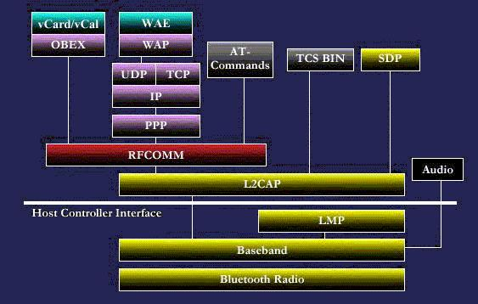

Slide 137
Link Manager layer
The link manager layer specifies the establishment and release links, authentication, traffic scheduling, link supervision, and power management tasks. Responsible for all the physical link resources in the system. Handles the control and negotiation of packet sizes used when transmitting data.Sets up, terminates, and manages baseband connections between devices.

Slide 138
L2CAP layer
The Logical Link Control and Adaptation Protocol (L2CAP) layer handles the multiplexing of higher layer protocols and the segmentation and reassembly (SAR) of large packets The L2CAP layer provides both connectionless and connection-oriented services

Slide 139
L2CAP performs 4 major functions
Managing the creation and termination of logical links for each connection through channel structures. Adapting Data, for each connection, between application (APIs) and Bluetooth Baseband formats through Segmentation and Reassembly (SAR). Performing Multiplexing to support multiple concurrent connections over a single common radio interface (multiple apps. using link between two devices simultaneously). L2CAP segments large packets into smaller baseband manageable packets. Smaller received baseband packets are reassembled coming back up the protocol stack.

Slide 140
RFCOMM Applications may access L2CAP through different support protocols Service Discovery Protocol (SDP) RFCOMM Telephony Control Protocol Specification (TCS) TCP/IP based applications, for instance information transfer using the Wireless Application Protocol (WAP), can be extended to Bluetooth devices by using the Point-to-Point Protocol (PPP) on top of RFCOMM.

Slide 141
OBEX Protocol
The Object Exchange Protocol (OBEX) is a sessionlevel protocol for the exchange of objects This protocol can be used for example for phonebook, calendar or messaging synchronization, or for file transfer between connected devices.

Slide 142
TCSBIN Protocol
The telephony control specification - binary (TCS BIN) protocol defines the call-control signaling for the establishment of speech and data calls between Bluetooth devices In addition, it defines mobility management procedures for handling groups of Bluetooth devices.

Slide 143
Service Discovery Protocol
The Service Discovery Protocol (SDP) can be used to access a specific device (such as a digital camera) and retrieve its capabilities, or to access a specific application (such as a print job) and find devices that support this application.

Slide 144
Raspberry Pi

Slide 145
What is a Raspberry Pi?
The Raspberry Pi is a very small computer that is almost the size of your credit card. It costs between Rs 750 and Rs 4000. It can function as a proper desktop computer or use to build smart devices and is available anywhere in the world.

Slide 146
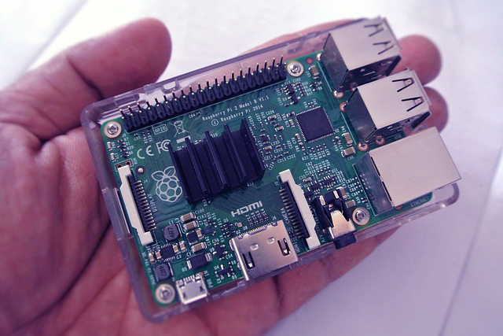

Slide 147
Who Invented IoT Raspberry Pi?
The Raspberry Pi Foundation was formed in the year 2008 after a group of technicians and academics who were concerned about students’ interest gradually drifting and declining in computer sciences. So they came up with a low-cost computer as a solution to inspire children and make it more accessible.
The basic motive was that these tiny computer systems might allow for very basic and simple programming. Its low electricity utilization and value expect to make Pis more easily to be used in school rooms.

Slide 148
When was IoT Raspberry Pi launched?
The first Raspberry Pi unit which was available commercially was launched on February 19, 2012. This version featured 256MB of RAM, could run on Linux-based desktop operating systems, had one USB port, and no Ethernet port. This was named the Model A.

Slide 149
What’s the Difference Between Raspberry Pi Models?
IoT Raspberry Pi models can be confusing because there are so many of them and there are two levels to the naming system.

Slide 150
The “generation” of the model, represent by Pi 1, Pi 2, and Pi 3 where Pi 1 is for models between 2012-14, Pi 2 is 2015 models, and Pi 3 is 2016 models. So 3 is the most recent which is better than 2, which is better than 1.
The power and features indicate by model A, A+, B, and B+. It’s not like grades though, A is lower than B.

Slide 151
Where is IoT Raspberry Pi’s used?

Slide 152
IoT Raspberry Pi can be used in a wide variety of tasks. It’s ideal and best suitable for projects where there is a computer requirement but you don’t require much processing power, you want to keep the costs low and want to save on space. Here’s a brief list of some ideal uses of the Pi.

Slide 153
Why is it called Raspberry Pi?

Slide 154
The “Raspberry” name is a homage to computer companies in early times that were being named after a fruit, like Apple, Apricot Computers, Tangerine Computer Systems. The idea to make a small computer to run only the Python programming language is where the “Pi” derives from.

Slide 155
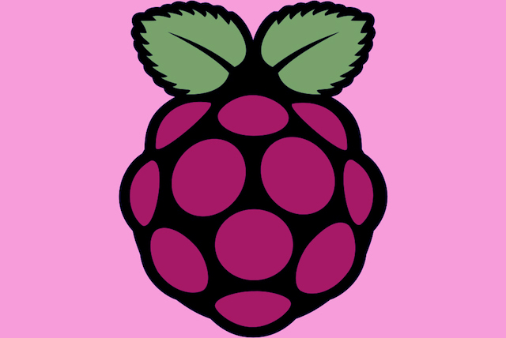

Slide 156
IoT and the Maker Movement

Slide 157
Another factor driving the momentous adoption of the IoT system is the rise of the maker culture. The maker culture encourages hobbyists (and professionals alike) to create their own devices as well as tinker with existing ones to find solutions to solve their specific problems.

Slide 158
With the maker movement comes a host of DIY electronic platforms, such as Arduino and Raspberry Pi. Arduino is a small and inexpensive electronic board that allows you to connect to various external accessories (such as sensors) and create applications to use the data collected.

Slide 159
Another open-source hardware platform that has got very popular with hobbyists these days is Raspberry Pi. It's really a computer, by all definitions. Raspberry Pi is a low-cost, credit card-sized computer that connects to a computer monitor or TV using HDMI, and uses a standard keyboard and mouse. It can run a host of operating systems, such as Raspbian (Debian Linux), Android, Windows 10, IoT Core, etc.

Slide 160
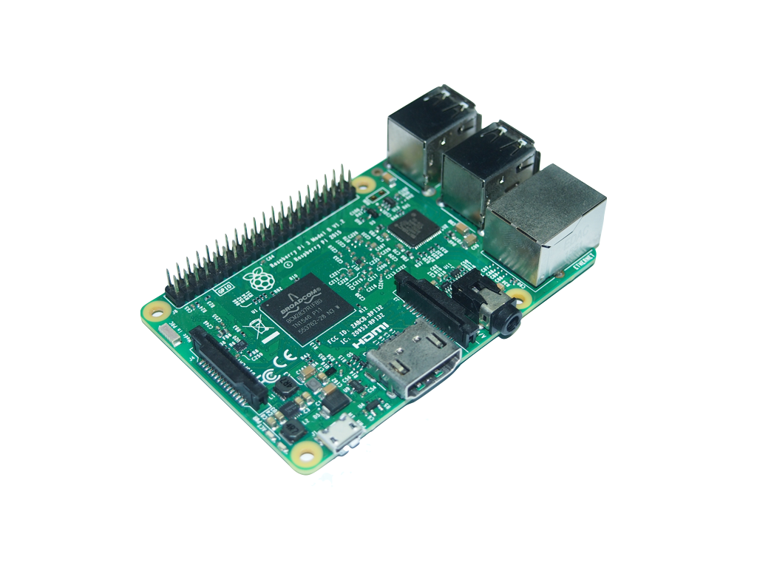
The Raspberry Pi 3

Slide 161
Raspberry Pi 3 is the third generation of Raspberry Pi and it packs quite a formidable punch in its credit card-sized package. Most notably, in addition to the standard features of the Raspberry Pi (such as four USB 2.0 ports and built-in Ethernet), it has:
A 1.2GHz 64-bit quad-core ARMv8 CPU
802.11n Wireless LAN
Bluetooth 4.1 Low Energy (BLE)
The powerful CPU coupled with Wireless LAN and Bluetooth 4.1 radio makes it an ideal candidate for IoT projects, because multiple sensors can be connected to it simultaneously. In addition, the Raspberry Pi has a 40-pin GPIO (General Purpose I/O) connector for interfacing with external sensors.

Slide 162
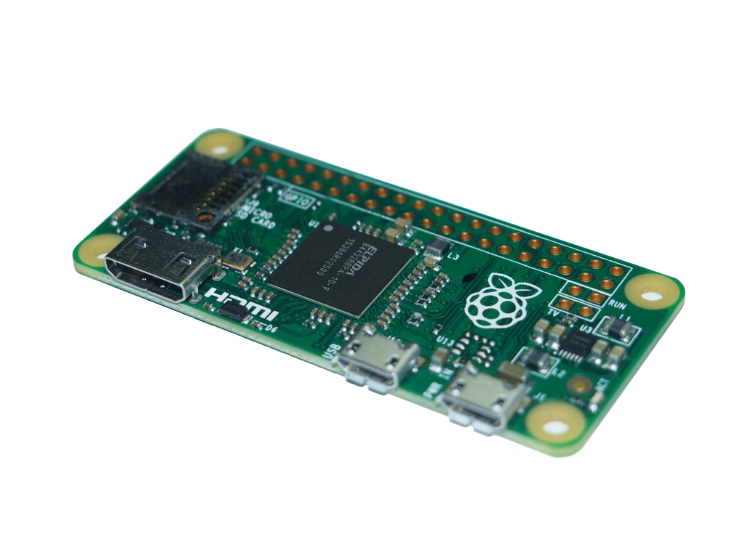
The Raspberry Pi Zero

Slide 163
The Raspberry Pi Zero is the smallest Raspberry Pi ever made, and although it doesn't have a processor that's as powerful as the Pi 3, its small size is especially suited for embedded projects (such as wearables, etc.), where space is a premium.

Slide 164
Google Cloud Messaging

Slide 165
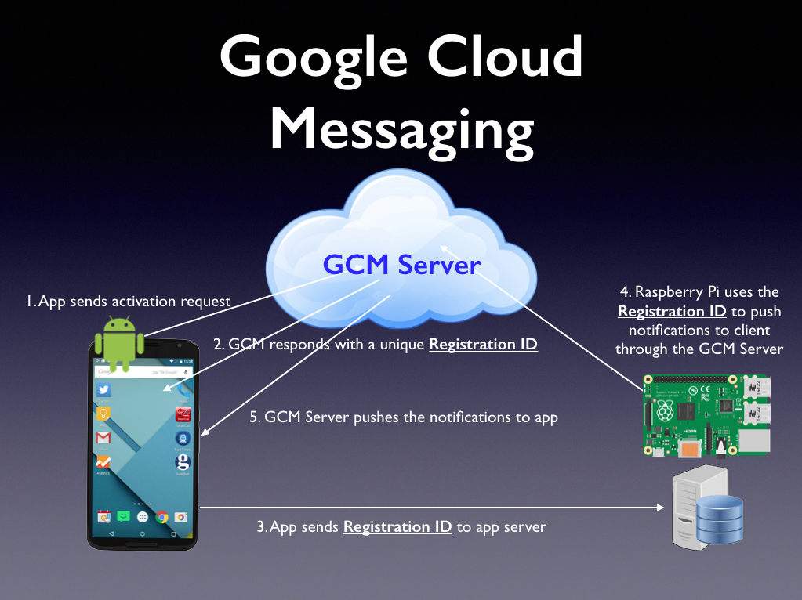

Slide 166
The Android app sends an activation request to Google's GCM Server.
When the registration is successful, the GCM Server returns a Registration ID to the app.
In the real world, the Registration ID should be sent to a server maintained by the developer, who will then save it into a database.

Slide 167
The developer also needs to write another application to communicate with the GCM server to send the push notification to a particular user(s). In this project, we'll use the Raspberry Pi to send the message to a user via the GCM Server.
Once the GCM server receives the message, it sends the push notification to the app.
To send a push message via Google's GCM server, you can use a variety of programming languages, such as C#, Python, Node.js, etc. Because Python is already supported in Raspbian, it's natural to use it.

Slide 168
Arduino

Slide 169
Arduino is an open-source electronics platform based on easy-to-use hardware and software. Arduino boards are able to read inputs - light on a sensor, a finger on a button, or a Twitter message - and turn it into an output - activating a motor, turning on an LED, publishing something online.

Slide 170
You can tell your board what to do by sending a set of instructions to the microcontroller on the board. To do so you use the Arduino programming language (based on Wiring), and the Arduino Software (IDE), based on Processing.

Slide 171
Over the years Arduino has been the brain of thousands of projects, from everyday objects to complex scientific instruments. A worldwide community of makers - students, hobbyists, artists, programmers, and professionals - has gathered around this open-source platform

Slide 172
Arduino was born at the Ivrea Interaction Design Institute as an easy tool for fast prototyping, aimed at students without a background in electronics and programming.

Slide 173
As soon as it reached a wider community, the Arduino board started changing to adapt to new needs and challenges, differentiating its offer from simple 8-bit boards to products for IoT applications, wearable, 3D printing, and embedded environments.

Slide 174
All Arduino boards are completely open-source, empowering users to build them independently and eventually adapt them to their particular needs. The software, too, is open-source, and it is growing through the contributions of users worldwide.

Slide 175
Why Arduino?

Slide 176
The Arduino software is easy-to-use for beginners, yet flexible enough for advanced users. It runs on Mac, Windows, and Linux. Teachers and students use it to build low cost scientific instruments, to prove chemistry and physics principles, or to get started with programming and robotics.

Slide 177
Makers, of course, use it to build many of the projects exhibited at the Maker Faire, for example. Arduino is a key tool to learn new things. Anyone - children, hobbyists, artists, programmers - can start tinkering just following the step by step instructions of a kit, or sharing ideas online with other members of the Arduino community.

Slide 178
There are many other microcontrollers and microcontroller platforms available for physical computing. Parallax Basic Stamp, Netmedia's BX-24, Phidgets, MIT's Handyboard, and many others offer similar functionality.

Slide 179
Arduino also simplifies the process of working with microcontrollers, but it offers some advantage for teachers, students, and interested amateurs over other systems:

Slide 180
Inexpensive - Arduino boards are relatively inexpensive compared to other microcontroller platforms. The least expensive version of the Arduino module can be assembled by hand, and even the pre-assembled Arduino modules cost is less

Slide 181
Cross-platform - The Arduino Software (IDE) runs on Windows, Macintosh OSX, and Linux operating systems. Most microcontroller systems are limited to Windows.

Slide 182
Simple, clear programming environment - The Arduino Software (IDE) is easy-to-use for beginners, yet flexible enough for advanced users to take advantage of as well. For teachers, it's conveniently based on the Processing programming environment, so students learning to program in that environment will be familiar with how the Arduino IDE works.

Slide 183
Open source and extensible software - The Arduino software is published as open source tools, available for extension by experienced programmers. The language can be expanded through C++ libraries, and people wanting to understand the technical details can make the leap from Arduino to the AVR C programming language on which it's based.

Slide 184
Open source and extensible hardware - The plans of the Arduino boards are published under a Creative Commons license, so experienced circuit designers can make their own version of the module, extending it and improving it. Even relatively inexperienced users can build the breadboard version of the module in order to understand how it works and save money.

Slide 185
Arduino Uno Board Anatomy

Slide 186
Arduino boards senses the environment by receiving inputs from many sensors, and affects their surroundings by controlling lights, motors, and other actuators. Arduino boards are the microcontroller development platform that will be at the heart of your projects. When making something you will be building the circuits and interfaces for interaction, and telling the microcontroller how to interface with other components.

Slide 187
Here the anatomy of Arduino Uno.
Digital pins Use these pins with digitalRead(), digitalWrite(), and analogWrite(). analogWrite() works only on the pins with the PWM symbol.
Pin 13 LED The only actuator built-in to your board. Besides being a handy target for your first blink sketch, this LED is very useful for debugging.

Slide 188
Power LED Indicates that your Arduino is receiving power. Useful for debugging.
ATmega microcontroller The heart of your board.
Analog in Use these pins with analogRead().
GND and 5V pins Use these pins to provide +5V power and ground to your circuits.

Slide 189
Power connector This is how you power your Arduino when it's not plugged into a USB port for power. Can accept voltages between 7-12V.
TX and RX LEDs These LEDs indicate communication between your Arduino and your computer. Expect them to flicker rapidly during sketch upload as well as during serial communication. Useful for debugging.

Slide 190
USB port Used for powering your Arduino Uno, uploading your sketches to your Arduino, and for communicating with your Arduino sketch (via Serial. println() etc.).
Reset button Resets the ATmega microcontroller.

Slide 191
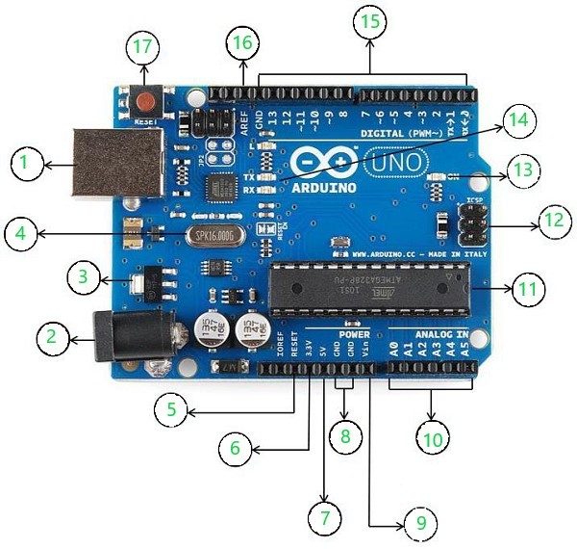

Slide 192
The labeled components of the board :
USB: can be used for both power and communication with the IDE
Barrel Jack: used for power supply
Voltage Regulator: regulates and stabilizes the input and output voltages
Crystal Oscillator: keeps track of time and regulates processor frequency
Reset Pin: can be used to reset the Arduino Uno
3.3V pin: can be used as a 3.3V output
5V pin: can be used as a 5V output

Slide 193
8.GND pin: can be used to ground the circuit
9.Vin pin: can be used to supply power to the board
10.Analog pins(A0-A5): can be used to read analog signals to the board
11.Microcontroller(ATMega328): the processing and logical unit of the board
12.ICSP pin: a programming header on the board also called SPI

Slide 194
13.Power indicator LED: indicates the power status of the board
14.RX and TX LEDs: receive(RX) and transmit(TX) LEDs, blink when sending or receiving serial data respectively
15.Digital I/O pins: 14 pins capable of reading and outputting digital signals; 6 of these pins are also capable of PWM
16.AREF pins: can be used to set an external reference voltage as the upper limit for the analog pins
17.Reset button: can be used to reset the board

Slide 195
Arduino Software (IDE)

Slide 196
The Arduino Integrated Development Environment - or Arduino Software (IDE) - contains a text editor for writing code, a message area, a text console, a toolbar with buttons for common functions and a series of menus. It connects to the Arduino hardware to upload programs and communicate with them.

Slide 197
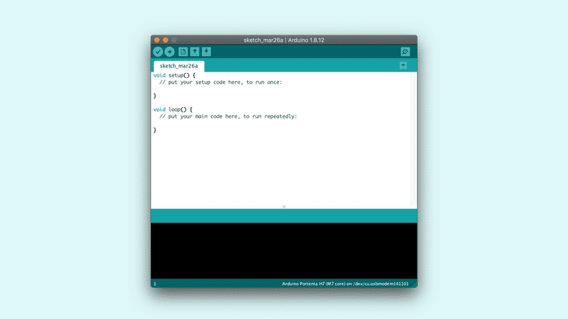

Slide 198
Writing Sketches
Programs written using Arduino Software (IDE) are called sketches. These sketches are written in the text editor and are saved with the file extension .ino.

Slide 199
The editor has features for cutting/pasting and for searching/replacing text. The message area gives feedback while saving and exporting and also displays errors. The console displays text output by the Arduino Software (IDE), including complete error messages and other information.

Slide 200
The toolbar buttons allow you to verify and upload programs, create, open, and save sketches, and open the serial monitor.

Slide 201
Verify Checks your code for errors compiling it.
Upload Compiles your code and uploads it to the configured board.
New Creates a new sketch.
Open Presents a menu of all the sketches in your sketchbook. Clicking one will open it within the current window overwriting its content.
Save Saves your sketch.
Serial Monitor Opens the serial monitor.

Slide 202
Additional commands are found within the five menus: File, Edit, Sketch, Tools, HelpThe menus are context sensitive, which means only those items relevant to the work currently being carried out are available.

Slide 203
File
New Creates a new instance of the editor, with the bare minimum structure of a sketch already in place.
Open Allows to load a sketch file browsing through the computer drives and folders.
Open Recent Provides a short list of the most recent sketches, ready to be opened.

Slide 204
Sketchbook Shows the current sketches within the sketchbook folder structure; clicking on any name opens the corresponding sketch in a new editor instance.
Examples Any example provided by the Arduino Software (IDE) or library shows up in this menu item. All the examples are structured in a tree that allows easy access by topic or library.
Close Closes the instance of the Arduino Software from which it is clicked.

Slide 205
Save Saves the sketch with the current name. If the file hasn't been named before, a name will be provided in a "Save as.." window.
Save as... Allows to save the current sketch with a different name.
Page Setup It shows the Page Setup window for printing.
Print Sends the current sketch to the printer according to the settings defined in Page Setup.

Slide 206
Preferences Opens the Preferences window where some settings of the IDE may be customized, as the language of the IDE interface.
Quit Closes all IDE windows. The same sketches open when Quit was chosen will be automatically reopened the next time you start the IDE.

Slide 207
Edit
Undo/Redo Goes back of one or more steps you did while editing; when you go back, you may go forward with Redo.
Cut Removes the selected text from the editor and places it into the clipboard.
Copy Duplicates the selected text in the editor and places it into the clipboard.

Slide 208
Copy for Forum Copies the code of your sketch to the clipboard in a form suitable for posting to the forum, complete with syntax coloring.
Paste Puts the contents of the clipboard at the cursor position, in the editor.
Select All Selects and highlights the whole content of the editor.

Slide 209
Find Opens the Find and Replace window where you can specify text to search inside the current sketch according to several options.
Find Next Highlights the next occurrence - if any - of the string specified as the search item in the Find window, relative to the cursor position.
Find Previous Highlights the previous occurrence - if any - of the string specified as the search item in the Find window relative to the cursor position.

Slide 210
Sketch
Verify/Compile Checks your sketch for errors compiling it; it will report memory usage for code and variables in the console area.
Upload Compiles and loads the binary file onto the configured board through the configured Port.

Slide 211
Upload Using Programmer This will overwrite the bootloader on the board; you will need to use Tools > Burn Bootloader to restore it and be able to Upload to USB serial port again. However, it allows you to use the full capacity of the Flash memory for your sketch. Please note that this command will NOT burn the fuses. To do so a Tools -> Burn Bootloader command must be executed.

Slide 212
Export Compiled Binary Saves a .hex file that may be kept as archive or sent to the board using other tools.
Show Sketch Folder Opens the current sketch folder.
Include Library Adds a library to your sketch by inserting #include statements at the start of your code. For more details, see libraries below. Additionally, from this menu item you can access the Library Manager and import new libraries from .zip files.

Slide 213
Tools
Auto Format This formats your code nicely: i.e. indents it so that opening and closing curly braces line up, and that the statements inside curly braces are indented more.
Archive Sketch Archives a copy of the current sketch in .zip format. The archive is placed in the same directory as the sketch.

Slide 214
Archive Sketch Archives a copy of the current sketch in .zip format. The archive is placed in the same directory as the sketch.
Fix Encoding & Reload Fixes possible discrepancies between the editor char map encoding and other operating systems char maps.
Serial Monitor Opens the serial monitor window and initiates the exchange of data with any connected board on the currently selected Port. This usually resets the board, if the board supports Reset over serial port opening.

Slide 215
Port This menu contains all the serial devices (real or virtual) on your machine. It should automatically refresh every time you open the top-level tools menu.
Programmer For selecting a harware programmer when programming a board or chip and not using the onboard USB-serial connection.

Slide 216
Intel Galileo
Galileo is a microcontroller board based on 32-bit Intel Pentium-class system on a chip. It’s the first board based on Intel architecture designed to be hardware and software . .
Galileo is designed to support shields that operate at either 3.3V or 5V. The core operating voltage of Galileo is 3.3V. However, a jumper on the board enables voltage translation to 5V at the I/O pins.

Slide 217
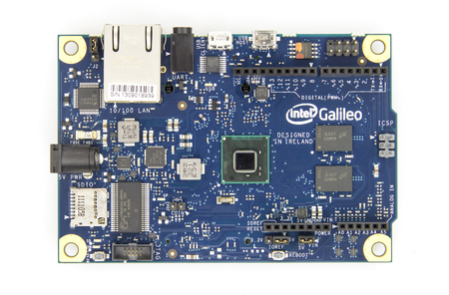
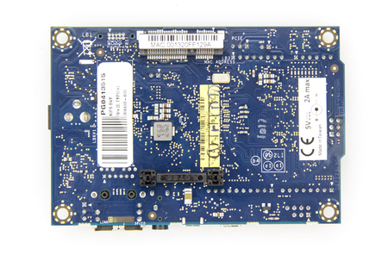
Intel galileo

Slide 218
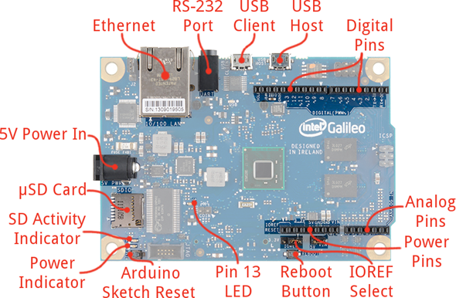

Slide 219
The Galileo board is also software compatible with the Arduino Software Development Environment (IDE), which makes usability and introduction a snap. In addition to Arduino hardware and software compatibility, the Galileo board has several PC industry standard I/O ports and features to expand native usage and capabilities beyond the Arduino shield ecosystem.

Slide 220
A full sized mini-PCI Express slot, 100Mb Ethernet port, Micro-SD slot, RS-232 serial port, USB Host port, USB Client port, and 8MByte NOR flash come standard on the board.

Slide 221
Benefits
The Galileo board is also software compatible with the Arduino Software Development Environment (IDE), that makes usability and introduction a snap.
The Galileo board has several PC industry standard I/O ports and features to expand native usage and capabilities beyond the Arduino shield ecosystem.

Slide 222
A full-sized mini-PCI Express slot, 100Mb Ethernet port, Micro-SD slot, RS-232 serial port, USB Host port, USB Client port, and 8MByte NOR flash come standard on the board.
Using an Intel Galileo Board you can create your own world of Internet of Things (IoT) by writing just a few sketches.

Slide 223
Power
Galileo is powered via an AC-to-DC adapter, connected by plugging a 2.1mm center-positive plug into the board's power jack. The recommended output rating of the power adapter is 5V at up to 3Amp.

Slide 224
Communication
Galileo has a number of facilities for communicating with a computer, another Arduino, or other microcontrollers. Galileo provides UART TTL (5V/3.3V) serial communication, which is available on digital pin 0 (RX) and 1 (TX).

Slide 225
In addition, a second UART provides RS-232 support and is connected via a 3.5mm jack. The USB Device ports allows for serial (CDC) communications over USB. This provides a serial connection to the Serial Monitor or other applications on your computer. It also enables Galileo to act as a USB mouse or keyboard to an attached computer.

Slide 226
The USB Host port allows Galileo act as a USB Host for connected peripherals such as mice, keyboards, and smartphones. To use these features, see the USBHost reference pages. Galileo is the first Arduino board to provide a mini PCI Express (mPCIe) slot. This slot allows full size and half size (with adapter) mPCIe modules to be connected to the board and also provides an additional USB Host port via the slot. Any standard mPCIe module can be connected and used to provide applications such as WiFi, Bluetooth or Cellular connectivity.

Slide 227
Initially, the Galileo mPCie slot provides support for the WiFi Library. An Ethernet RJ45 Connector is provided to allow Galileo to connect to wired networks. When connecting to a network, you must provide an IP address and a MAC address. Full support of on-board Ethernet interface is fully supported and does not require the use of the SPI interface like existing Arduino shields.

Slide 228
The onboard microSD card reader is accessible through the SD Library. The communication between Galileo and the SD card is provided by an integrated SD controller and does not require the use of the SPI interface like other Arduino boards. The Arduino software includes a Wire library to simplify use of the TWI/I2C bus.

Slide 229
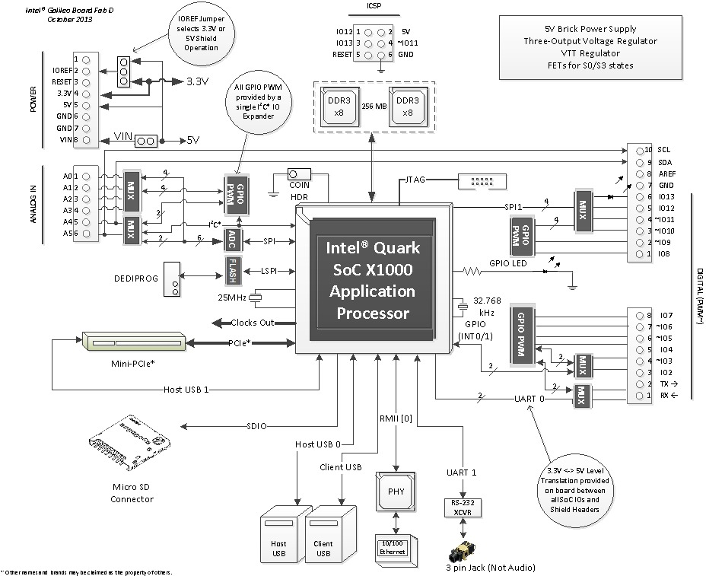

Slide 230
Galileo Jumper Configuration
There are three jumpers on Galileo that are used to vary the configuration of the board. IOREF Jumper To allow Galileo support both 3.3V and 5V shields, the external operating voltage is controlled via a jumper. When the jumper is connected to 5V, Galileo is configured to be compatible with 5V shields and IOREF is set to 5V.

Slide 231
When the jumper is connected 3.3V, Galileo is configured to be compatible with 3.3V shields and IOREF is set to 3.3V. The input range of the Analog pins is also controlled by the IOREF jumper and must not exceed the chosen operating voltage.

Slide 232
The IOREF jumper should be used to match the board and shield operating voltages. Incorrectly setting the voltage could damage the board or the shield. I2C Address Jumper To prevent a clash between the I2C Slave address of the on board I/O expander and EEPROM with any external I2C Slave devices, jumper J2 can be used to vary the I2C address of the on-board devices.

Slide 233
. With J2 connected to pin 1 (marked with white triangle), the 7-bit I/O Expander address is 0100001 and the 7-bit EEPROM address is 1010001. Changing the jumper position changes the I/O Expander address to 0100000 and the EEPROM address to 1010000. VIN Jumper On Galileo, the VIN pin can be used to supply 5V from the regulated power supply connected at the power jack to attached shields or devices.

Slide 234
If there is a need to supply more than 5V to a shield using VIN then the VIN jumper should be removed from Galileo to break the connection between the on-board 5V supply and the VIN connection on the board header.
If the VIN jumper is not removed and more than 5V is connected to VIN, it may damage the board or lead to unreliable operation.

Slide 235
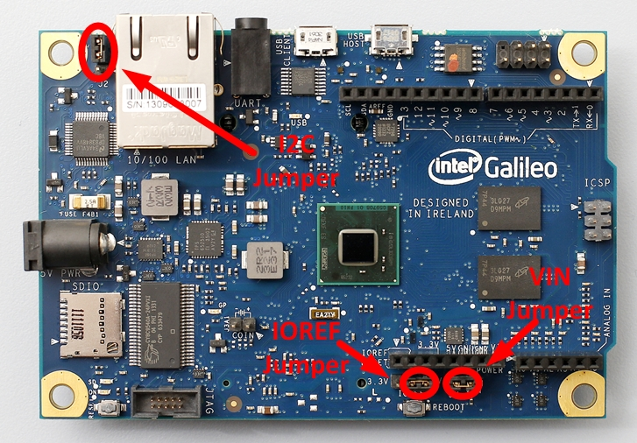

Slide 236
Automatic (Software) Reset
Rather than requiring a physical press of the reset button before an upload, Galileo is designed in a way that allows it to be reset by software running on a connected computer. USB CDC-ACM control signals are used to transition Galileo from run-time to bootloader mode. The Arduino software uses this capability to allow you to upload code by simply pressing the upload button in the Arduino environment.

Slide 237
Physical Characteristics
Galileo is 4.2 inches long and 2.8 inches wide respectively, with the USB connectors, UART jack, Ethernet connector, and power jack extending beyond the former dimension. Four screw holes allow the board to be attached to a surface or case. Note that the distance between digital pins 7 and 8 is 160 mil (0.16"), is not an even multiple of the 100 mil spacing of the other pins

Slide 238
New tools for innovation
Introducing the Intel® Galileo development board, the first product in a new family of Arduino-compatible development boards featuring Intel® architecture. The platform is easy to use for new designers and for those looking to take designs to the next level. Intel recognizes that the people who take creating beautiful things into their own hands with innovation and technology are the same ones that propel us forward.

Slide 239
The Intel Galileo development board is a great tool for quickly prototyping simple, interactive designs such as LED light displays that respond to social media, or for tackling more complex projects, from automating home appliances to building life-size robots controlled by a smartphone.

Slide 240
This platform provides the ease of Intel architecture development through support for the Microsoft Windows*, Mac OS* and Linux* host operating systems. It also brings the simplicity of the Arduino software integrated development environment (IDE). It's all about delivering Intel performance and quality to the DIY maker community to support invention and creativity.

Slide 241
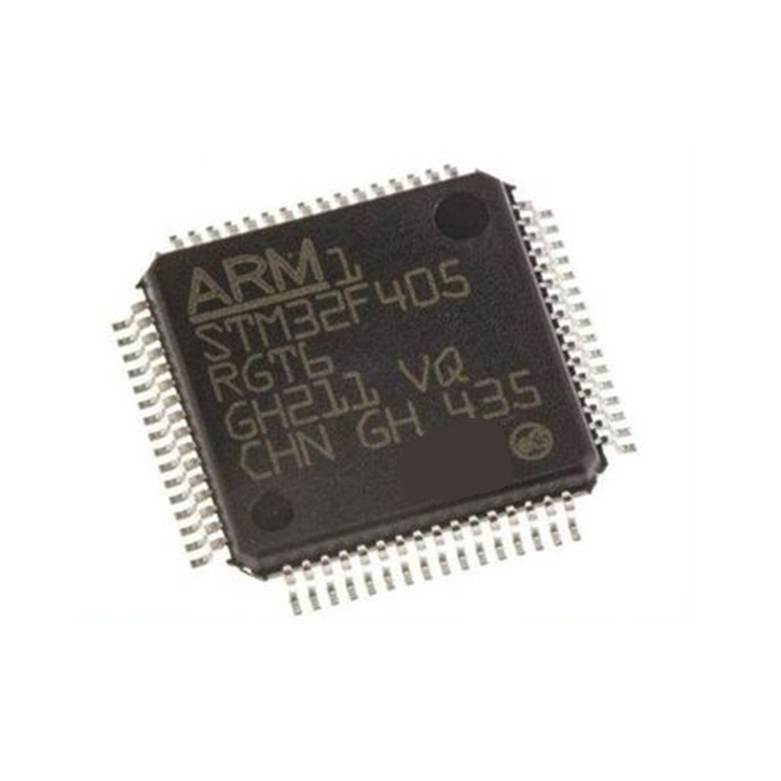
ARM CORTEX

Slide 242
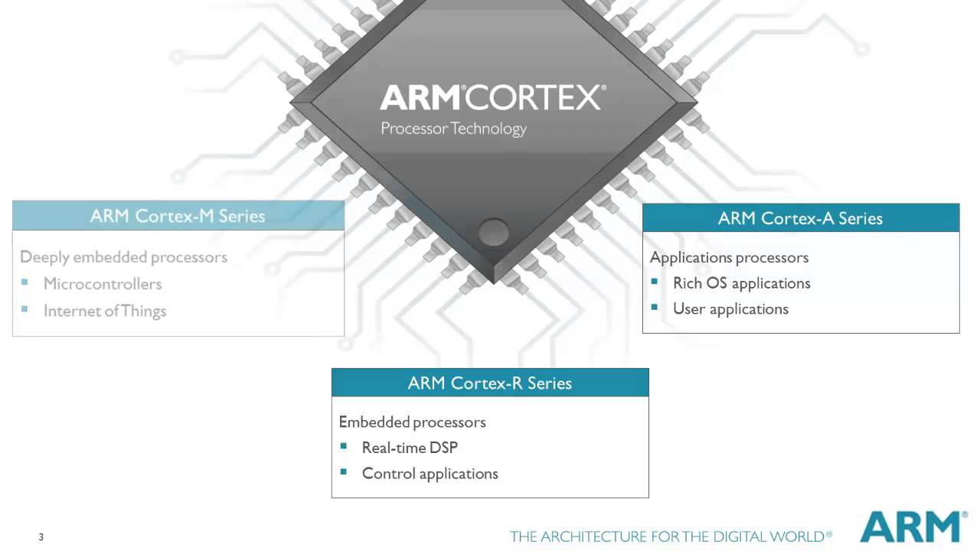
ARM CORTEX

Slide 243
ARM Cortex
Based on ARM embedded processors address many different market segments including enterprise applications, automotive systems, home networking and wireless technologies.
A profile for sophisticated, high-end applications running open and complex operating systems

Slide 244
ARM Cortex
It has been specifically designed to achieve high system performance in power- and cost-sensitive embedded applications, such as microcontrollers, automotive body systems, industrial control systems and wireless networking, while significantly simplifying programmability to make the ARM.

Slide 245
There have been several generations of the ARM design. The original ARM1 used a 32-bit internal structure but had a 26-bit address space that limited it to 64 MB of main memory. This limitation was removed in the ARMv3 series, which has a 32-bit address space, and several additional generations up to ARMv7 remained 32-bit.

Slide 246
the ARMv8-A architecture added support for a 64-bit address space and 64-bit arithmetic with its new 32-bit fixed-length instruction set.Arm Ltd. has also released a series of additional instruction sets for different rules; the "Thumb" extension adds both 32- and 16-bit instructions for improved code density, while Jazelle added instructions for directly handling Java bytecodes, and more recently, JavaScript. More recent changes include the addition of simultaneous multithreading (SMT) for improved performance or fault tolerance.

Slide 247
Due to their low costs, minimal power consumption, and lower heat generation than their competitors, ARM processors are desirable for light, portable, battery-powered devices — including smartphones, laptops and tablet computers, as well as other embedded systems.

Slide 248
However, ARM processors are also used for desktops and servers, including the world's fastest supercomputer. With over 180 billion ARM chips produced, as of 2021, ARM is the most widely used instruction set architecture (ISA) and the ISA produced in the largest quantity. Currently, the widely used Cortex cores, older "classic" cores, and specialised SecurCore cores variants are available for each of these to include or exclude optional capabilities.

Slide 249
ARM1
Acorn chose VLSI Technology as the "silicon partner",as they were a source of ROMs and custom chips for Acorn. Acorn provided the design and VLSI provided the layout and production. The first samples of ARM silicon worked properly when first received and tested on 26 April 1985. Known as ARM1.

Slide 250
The first ARM application was as a second processor for the BBC Micro, where it helped in developing simulation software to finish development of the support chips (VIDC, IOC, MEMC), and sped up the CAD software used in ARM2 development. Wilson subsequently rewrote BBC BASIC in ARM assembly language. The in-depth knowledge gained from designing the instruction set enabled the code to be very dense, making ARM BBC BASIC an extremely good test for any ARM emulator.

Slide 252
ARM2
The result of the simulations on the ARM1 boards led to the late 1986 introduction of the ARM2 design running at 8 MHz, and the early 1987 speed-bumped version at 10 to 12 MHz.A significant change in the underlying architecture was the addition of a Booth multiplier, whereas previously multiplication had to be carried out in software.

Slide 253
Additionally, a new Fast Interrupt reQuest mode, FIQ for short, allowed registers 8 through 14 to be replaced as part of the interrupt itself. This meant FIQ requests did not have to save out their registers, further speeding interrupts.

Slide 254
It was twice as fast as a Intel 80386 running at 16 MHz, and about the same speed as a multi-processor VAX-11/784 supermini. The only systems that beat it were the Sun SPARC and MIPS R2000 RISC-based workstations.[39] Further, as the CPU was designed for high-speed I/O, it dispensed with many of the support chips seen in these machines, notably, it lacked any dedicated direct memory access (DMA) controller which was often found on workstations.

Slide 255
The graphics system was also simplified based on the same set of underlying assumptions about memory and timing. The result was a dramatically simplified design, offering performance on par with expensive workstations but at a price point similar to contemporary desktops. The ARM2 featured a 32-bit data bus, 26-bit address space and 27 32-bit registers. The ARM2 had a transistor count of just 30,000, compared to Motorola's six-year-older 68000 model with around 40,000.

Slide 256
This simplicity enabled low power consumption, yet better performance than the Intel 80286. A successor, ARM3, was produced with a 4 KB cache, which further improved performance. The address bus was extended to 32 bits in the ARM6, but program code still had to lie within the first 64 MB of memory in 26-bit compatibility mode, due to the reserved bits for the status flags.

Slide 257
Higher performance through better efficiency
In order to achieve higher performance, processors can either work hard or work smart.
higher clock frequencies may increase performance but is also accompanied by higher power
consumption and design complexity. On the other hand, higher compute efficiency at slower clock
speeds results in simpler and lower power designs that can perform the same tasks.

Slide 258
At the heart of the Cortex-M3 processor is an advanced 3-stage pipeline core, based on the Harvard architecture,
that incorporates many new powerful features such as branch speculation, single cycle multiply and
hardware divide to deliver an exceptional Dhrystone benchmark performance of 1.25 DMIPS/MHz.

Slide 259
The Cortex-M3 processor also implements the new Thumb®-2 instruction set architecture,
to be 70% more efficient per MHz than an ARM7TDMI-S® processor executing Thumb instructions,
and 35% more efficient than the ARM7TDMI-S processor executing ARM instructions, for the Dhrystone benchmark.

Slide 260
Ease of use for quick and efficient application development
Reducing time-to-market and lowering development costs are critical criteria in the choice of microcontrollers, and the ability to quickly and easily develop software is key to these requirements.
The Cortex-M3 processor has been designed to be fast and easy to program, with the users not required to write any assembler code or have deep knowledge of the architecture to create simple applications.

Slide 261
The processor has a simplified stack-based programmer’s model which still maintains compatibility with the traditional ARM architecture but is analogous to the systems employed by legacy 8- and 16-bit architectures, making the transition to 32-bit easier.

Slide 262
Additionally a hardwarebased
interrupt scheme means that writing interrupt service routines (handlers) becomes trivial, and that start-up code is now significantly simplified as no assembler code register manipulation is required.

Slide 263
Key new features in the underlying Thumb-2 Instruction Set Architecture (ISA) implement C code more naturally, with native bitfield manipulation, hardware division and If/Then instructions. Further, from a development perspective, Thumb-2 instructions speed up development and simplify long term maintenance and support of compiled objects through automatic optimization for both performance and code density, without the need for complex interworking between code compiled for ARM or Thumb modes.

Slide 264
ARM6
In the late 1980s, Apple Computer and VLSI Technology started working with Acorn on newer versions of the ARM core. In 1990, Acorn spun off the design team into a new company named Advanced RISC Machines Ltd.,which became ARM Ltd. when its parent company, Arm Holdings plc, floated on the London Stock Exchange and NASDAQ in 1998.[46] The new Apple- ARM work would eventually evolve into the ARM6, first released in early 1992. Apple used the ARM6-based ARM610 as the basis for their Apple Newton PDA.

Slide 266
Reduced costs and lower power for sensitive markets
A constant barrier to the adoption of higher performance microcontrollers has always been cost.
Advanced manufacturing technologies are expensive and therefore smaller silicon area
requirements can reduce costs significantly.

Slide 267
The Cortex-M3 processor reduces system area by implementing the smallest ARM core to date, with just 33,000 gates in the central core (0.18um G) and by efficiently incorporating tightly coupled system components in the processor. Memory requirements are minimized by implementing unaligned data storage, atomic bit manipulation and
the Thumb-2 instruction set that reduces instruction memory requirements for the Dhrystone benchmark by more than 25% compared to ARM instructions.

Slide 268
In order to address the increasing need for energy conservation in markets like white goods and
wireless networking, the Cortex-M3 processor supports extensive clock gating and integrated sleep
modes. Enabled by these features, the processor delivers a power consumption of just 4.5mW and
a silicon footprint of 0.30mm2 when implemented at a target frequency of 50MHz on the TSMC
0.13G process using ARM Metro™ standard cells.

Slide 269
Integrated debug and trace for faster time to market
Embedded systems typically have no graphical user interface making software debug a special challenge for programmers. In-circuit Emulator (ICE) units have traditionally been used as plug-in devices to provide a window into the system through a familiar PC interface.

Slide 270
. As systems get smaller and more complex, physically attaching such debug units is no longer a viable solution. The Cortex-M3 processor implements debug technology in the hardware itself with several integrated components that facilitate quicker debug with trace & profiling, breakpoints, watchpoints and code patching, significantly reducing time to market.

Slide 271
WERABLE DEVELOPMENT BOARDS
Wearable devices are creating great buzz in the market and has become the trend of the day. Innovations are more focused on body-borne computers (also referred as wearables) which are miniature electronic devices that are worn on face, wrist, clothes or even shoes!
Eco-system of wearable devices involves extensive product development knowledge and expertise in technology areas from hardware design to cloud applications to mobile application development.

Slide 272
Specifically, for developing wearable devices one requires following technology expertise:
Hardware / electronic design and development expertise for developing products with minimum form factor size. Moreover, power management expertise is a must-have to ensure that devices can last several days / weeks / months on a single battery charge.
BSP / firmware development expertise ensuring memory optimized driver development with minimum footprint, enhanced power management and highest performance in spite of low-end microcontroller.
Smartphone application development on Android and iPhone platforms to allow connectivity with the wearable device.

Slide 273
Cloud / web application for enabling M2M (machine-to-machine) / IoT (Internet of things) for remote monitoring and control.
Smartphone application development on Android and iPhone platforms to allow connectivity with the wearable device.
Cloud / web application for enabling M2M (machine-to-machine) / IoT (Internet of things) for remote monitoring and control.

Slide 274
Challenges
Complex hardware designing abilities smaller sized form factor development.
Knowledge of choosing the right components for size and efficient power management.
Certifications to ensure radiations do not affect human body.
Expertise in driver development for developing optimized drivers for new types of sensors.

Slide 275
Ability to develop code that fits on lower capacity RAM / flash.
Domain knowledge for efficient application development.
Ability to develop iPhone / Android / Windows applications.
Ability to develop Cloud / web / smartphone connectivity applications.

Slide 276
Input wearables are devices which get input from something and transmit it to the server, for example health monitoring devices. In medical electronics coupled with remote communication capabilities that can be used for developing such type of applications.
Output wearables are device those provide you some information like a smart watch or smart glasses. smart watch technology based on Pebble platform.

Slide 277
Hardware Development Services
In hardware design development, in the embedded domains for developing tiny devices. We understand that most critical aspect of wearable devices is power profiles that radically varies based on solutions. A smart watch for instance would at least need a battery that lasts for a week, while a health monitoring device may be expected to work for a month or so.

Slide 278
Key development considerations for wearables include:
Developing extremely small form factors.
Power management by using the right components and critical designs.
Sensor integration by using sensors such as accelerometers, gyroscopes, motion sensors, proximity sensors, magnetometers etc.
Using of power sensitive displays that require minimum energy.
Enclosure / housing designing support

Slide 279
Development Boards for IoT
Driver development for various sensors such as accelerometers, gyroscopes, motion sensors, proximity sensors, magnetometers etc.
Driver development for communication interfaces like BLE 4.0, NFC, RF and even using the 3.5 mm audio headphone jack.
Development of power management algorithms.
Power management by using the right components and critical designs.

Slide 280
Embedded / real-time application development services
Developing algorithms based on various type of sensors such as using combination of accelerometer, gyro meter and magnetometer for determining relative positions, sudden falls, acceleration, angle and so on.
Development of fast and intelligent data transfer protocols with minimum overheads considering both wired and wireless data transfer mechanisms
Development of over the air firmware upgrade / remote diagnostics and health monitoring protocols.
Integrating with smart phones.

Slide 281
Smart phone application development services
Developing communication protocols over BLE, NFC and 3.5 mm jack for getting data from the wearable devices.
Intelligence to take decisions based on the data, such as send event / alarm notifications over SMS, transferring data to the server.
Integrating navigation applications to give direction on an output type of wearable device such as a smart watch.

Slide 282
Cloud / web application development services
Developing applications in HTML5, Dot Net and Java with database servers such as SQL, Oracle, PostgreSQL, MySQL and application servers such as IIS, Tomcat and JBOSS.
Building applications for displaying real-time parameters, historical trends.
Remote configuration and supports over-the-air firmware upgrade.

Slide 283
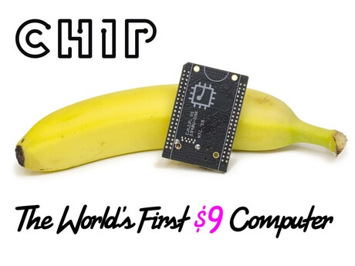
C.H.I.P

Slide 284
CHIP is the new kid on the block. With the $9 price tag, it’s one of the most affordable full-blown computers available in the market. It comes with a powerful 1GHz processor powered by Allwinner R8.
The best thing about CHIP is that it comes with embedded Bluetooth 4.0 and WiFi radios, providing out-of-the-box connectivity. The board has 4GB of high-speed storage to run a special Linux distribution based on Debian. You don’t need a separate SD Card to install and run the OS.

Slide 285
The only drawback of this board is that it doesn’t have HDMI out. To connect it to a display, you have to use a TRRS connector for the composite output. You may need an adapter to connect it to regular VGA or HDMI displays. Since CHIP supports headless operation, you can get started without ever connecting it to a display.

Slide 286
Mediatek Linkit One
Based on the smallest SOC, the Linkit One board comes with compatible Arduino pinout features. The chipset is based on MT2502A (Aster, ARM7 EJ-S (TM) ) with 260MHz speed. Regarding connectivity, Linkit One has the most comprehensive collection of radios – GPS, GSM, GPRS, WiFi, and Bluetooth.
One of the unique features of Linkit One is the rich API that can be used from Arduino IDE. The SDK comes with libraries to connect the board to AWS and PubNub. Because it supports the Arduino pinout, multiple shields from the Arduino ecosystem can be used with the board.

Slide 287
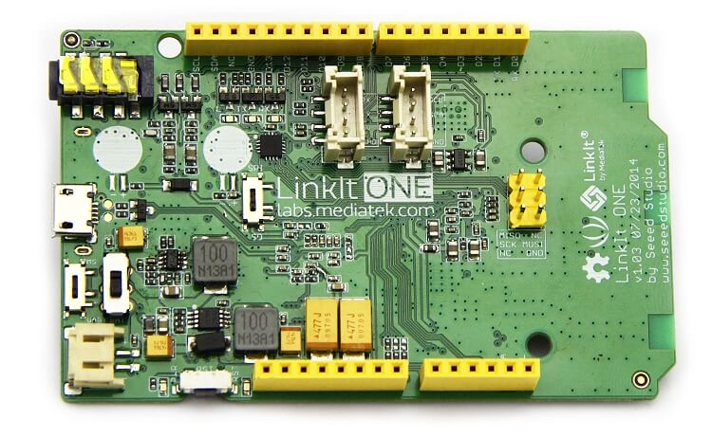
With small form-factor and rich connectivity options, Linkit One can be used for rapid prototyping of connected IoT devices and wearables.

Slide 288
Particle Photon
Photon is one of the smallest prototyping boards available in the market. It comes with the same Broadcom BCM43362 Wi-Fi chip that powers Next, LiFX, and Amazon Dash buttons. Powered by the STM32F205 120Mhz ARM Cortex M3 processor, Photon has 1MB flash and 128KB RAM. Once configured, the board is accessible from the Internet, which makes it an ideal prototyping platform to build connected applications.

Slide 289
The board comes with five analog pins and eight digital pins for connecting various sensors and actuators. The official iOS and Android Apps that Particle has published come handy in controlling these pins directly. The powerful web-based IDE lets you write sketches that are compatible with Arduino.

Slide 290
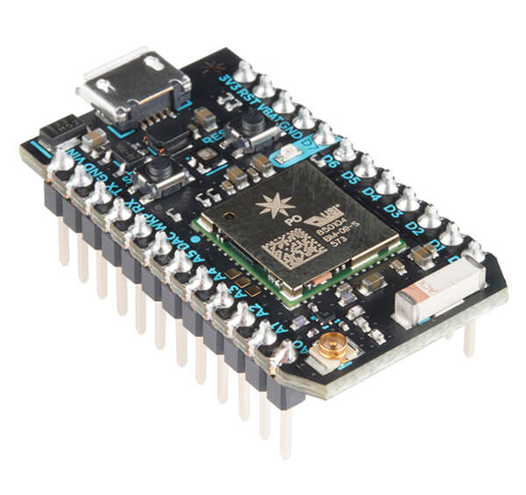

Slide 291
Tessel
Tessel 2 is a solid development board for serious developers. It comes with a choice of sensors and actuators that can be directly connected to the module ports. The board is powered by a 580MHz MediaTek MT7620n processor for faster execution. It is complemented by a 48MHz Atmel SAMD21 coprocessor for better managing the power and real-time I/O.

Slide 292
It has 64 MB DDR2 RAM & 32 MB Flash, which is more than sufficient for running complex code. The Micro-USB port is used for both powering the board as well as connecting to the PC. The embedded Wi-Fi and Ethernet ports bring connectivity to Tessel.
It has a wide collection of sensors and actuators that come along with the required libraries. Based on JavaScript and Node.js, it is easy to get started with the platform. Developers looking for a rapid prototyping platform can go for Tessel 2.

Slide 293
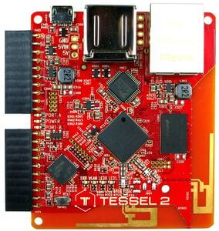
Tessel

Slide 294
the materials and methodology we used to test the two deployment scenarios for a remote health management system. We first describe the hardware to sense biometric signals using the eHealth Sensors kit and Arduino.

Slide 295
eHealth Sensors Kit
Arduino is an open-specification platform based on an ATmega328P micro-controller with the minimum capacity to execute simple programs Arduino provides an easy but effective hardware to connect and use many electronic components with a wide variety of applications

Slide 296
Arduino provides an excellent platform to test and prototype solutions by adding supplemental modules (Bluetooth,WiFi boards, LEDs, and servo-motors) andThis kit allows users to acquire a set of physiological signals such as ECG, EMG, breathing rate, surface temperature, GSR, blood glucose and SpO2 other hardware.

Slide 297
The Libelium kit is not a certified medical device. We used this platform as a virtual medical device because it implements the same physical interfaces and monitoring circuits as certified and commercial sensors do. Moreover, it prevents us from developing manufacturer protocols to retrieve raw physiological signals to test our principal hypothesis.

Slide 298
The whole sensing information detection part for biometric information relies on the Arduino eHealth Sensor Kit

Slide 300
These sensors can be used as diagnostic tools in clinical settings and also used to remotely monitor
the state of a patient in real time. Some of the sensors which use the electro-physiological techniques
(e.g., ECG, EMG, and GSR) require a time series to make a sense of them. All biometric sensors should be integrated on one Arduino board to collect comprehensive biometric information at the same time.

Slide 301
Choreography Integration
One of the objectives to improve health care services is to provide reliable remote access to the data retrieved by the sensors of the eHealth kit. A Service Oriented Architecture (SOA) involves the use of weakly coupled services to support such processes in a high inter-operable way.

Slide 302
In an SOA environment, network resources are available through services which can be accessed through standard methods. Masking such resources with services allows accessing them without the needs of knowing how they were implemented internally.

Slide 303
The software enabling communication between the sensors and the displaying interfaces was implemented using a choreography engine, a semantic engine capable of connecting registered services and functions.

Slide 304
The Choreographer dispatches messages among the modules using a specific
eXtensible Markup Language (XML) message protocol called eXtensible MeSsaGe (XMSG) XMSG is based on the Foundation for Intelligent Physical Agents (FIPA) recommendations and Simple Object Access Protocol (SOAP) headers to route and characterize messages.

Slide 305
The XMSG protocol allows broad-/multi-cast, as well as Peer to Peer (P2P) message calls, using custom symbols in the destination address. XMSG can be serialized and transmitted over any transport protocol such as REST and HTTP.

Slide 306
Services are designed to fit into three categories: serial communication, data translation and web-client. The client part is defined as a web service to deliver an interactive interface in a web browser. Serial communication service establishes the connection with the Arduino hardware to read data from wearable sensors.

Slide 307
The translator service verifies data packets and translates information
according to a predefined communication protocol. After extracting data from the packets, a new message is generated and sent to the client service to be displayed in web interface. These services also allow controlling the sensors (turn on/off, change sampling frequency, etc.).

Slide 308
the wearable sensors are connected to the Arduino + eHealth shield and how this component enables the communication to the Choreographer software (blue cross) in the Raspberry and other applications in the Pebble smart watch.

Slide 310
System architecture including health wearable sensors.

Slide 312
Communication Protocol
Once the sensors have been connected to the eHealth shield, the most important issue is to define a communication protocol to ensure correct data transmission. information should be handled between the webpage and the Arduino board through a distributed system (Sensors + Arduino in Location A and theWebpage in Location B).

Slide 313
This type of information involves sensor data (type of measurement, value, units, time stamp, etc.) and the control commands that manage the sensors. Besides, error detection mechanism should also be added since the messages may be corrupted during the transmission.

Slide 314
Two operational modes are defined for operating with sensors. This first is the Active mode, through which sensors can automatically collect and send measurements to the software at every time interval according to their individual settings. Thus, data from all sensors can be displayed in real-time.

Slide 315
The second is the passive mode, which implies that users can send different commands from the webpage to a specific sensor to request its data or change acquisition parameters. Users should be capable of interacting and operating with sensors: to request the current value of a sensor, to stop data retrieval, to set the time interval, etc.

Slide 316
the protocol should consider the following descriptors:
Kit Type: Type of the sensor kit used for extensions to other type of sensing environments such as smart homes.
Destination: Name of the sensor which identifies the destination of the command.
Command: Different commandswhich can be used to ask for the sensor data or change some default settings.

Slide 317
Parameter: This field corresponds to the Command field for changing some settings (e.g. transmit the parameter of the time interval in active mode).
Checksum: The checksum field is the 16 bit sum of all bytes of the command
packet. It can be used to detect command error which might be introduced during the transmission.

Slide 318
Sensor Type: Name of the sensor which sends data or response.
Response To: This field indicates which command the sensor is responding to, so the communication can be asynchronous.
Data: This is the data part measured by the sensors or the answer of the command.
Unit: This field corresponds to the Data field and it is the unit of the data.

Slide 319
Portable Embedded System
Raspberry Pi was introduced in 2012 and has been extensively used in home monitoring environments. It integrates a computer board with support for many input and outputperipherals through standard interfaces (Serial, Bluetooth and Wi-Fi) and allows the installation of several operative systems.

Slide 320
The device is cased and mounted inside a plastic box with a 7 inch touchscreen and powered with a battery. Raspberry Pi 3 is a platform suitable for embedding high level applications which allow the interaction with different devices and users in a wide range of applications

